Slide 1


Systems for Scalable Graph Analytics and Machine Learning: Trends and Methods
Da Yan*, Lyuheng Yuan, Akhlaque Ahmad, Saugat Adhikari
yanda@iu.edu
Department of Computer Science
Luddy School of Informatics, Computing, and Engineering
Indiana University Bloomington
Notes:
Good morning everyone! Welcome to our tutorial titled “Systems for Scalable Graph Analytics and Machine Learning: Trends and Methods”.
This tutorial is contributed by two groups from Indiana University Bloomington and the Chinese University of Hong Kong.
My name is Lyuheng Yuan from Indiana University Bloomington.
This tutorial is supposed to be delivered by 2 or 3 people, since it's a 3-hr tutorial. But unfortunately, there's some visa issues with the other authors, so I will be presenting all the materials in this long tutorial.
So hopefully you will enjoy this tutorial and don't get bored with the material.

Slide 2
Tutorial Outline
Structure Analytics (2 hrs)
Graph Neural Networks (1.5 hrs)
From the Systems Perspective!
Notes:
A real graph analytics pipeline often involves a combination of three types of graph operations, often including vertex analytics, structure analytics, and graph machine learning.
If you look at this figure, where you're given an input graph. You can first ...
[CLICK]
This tutorial focuses on the system design perspective of these graph operations. In other words, we will look at the problem mostly from efficiency perspective. I know in most AI problem, people cares about accuracy, such as precision/recall/F1-score these metrics. But in this tutorial, we will care more about the efficiency, or in other words, do we have faster methods to solve the same problem?
So the most works we mention and discussed will be from DB and HPC conferences.

Slide 3
Tutorial Outline
Subgraph Mining & Querying
Structure Analytics (2 hrs)
Graph Neural Networks (1.5 hrs)
Graph Deep Learning
Notes:
This tutorial is divided into two parts.
The first part is on structure analytics, which are based on conventional graph algorithms and graph mining methods,
The second part is on systems for training graph neural networks, which is a very hot topic right now.

Slide 4
Two Graph Computing Models
TLAV: Think Like a Vertex
Iterative
Output: one value per vertex/edge
Time complexity: O(|G| polylog |G|)
TLAT: Think Like a Task (or, Think Like a Subgraph)
Recursive, divide and conquer
Output: different subgraphs that may overlap
Time complexity: exponential to |G|
Notes:
This tutorial is divided into two parts.
The first part is on structure analytics, which are based on conventional graph algorithms and graph mining methods,
The second part is on systems for training graph neural networks, which is a very hot topic right now.

Slide 5
Think Like a Vertex (TLAV)
Low time complexity:
O(|E|) per iteration (message passing between vertices)
O(polylog(|G|)) iterations
Pregel-Like Systems
u₁
0.5
w₁
1
u₂
v
w₂
1
1
1
3
summation
u₃
w₃
1.5
v.compute(messages)
Simplified Illustration Without Damping
Notes:
First, let us review the TLAV model pioneered by Google’s Pregel.
This vertex-centric model asks users to write a compute function, which is run by each individual vertex to collectively complete a job.
Taking PageRank computation as an example, in the compute function, each vertex v first
[click]
gathers messages from its in-neighbors,
[click]
sums them up to become v’s new PageRank value, and then
[click]
divides it evenly to its out-neighbors.
You can see that, associated with a lot of message IOs, we simply do a message summation, so the execution is IO-bound and CPU is underutilized

Slide 6
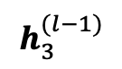
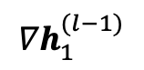
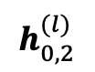
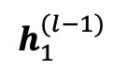
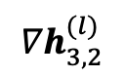
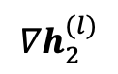
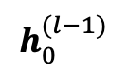
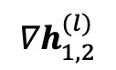
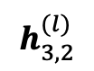
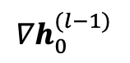
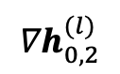
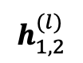
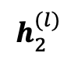
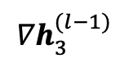
Think Like a Vertex (TLAV)
Vertex Embedding Gathering/Scattering
Graph Neural Networks (GNN)
2
3
$$h_{0}^{(l−1)}$$
0
W₁
$$h_{0,2}^{(l)}$$
Aggregate
$$h_{1}^{(l−1)}$$
1
W₁
$$h_{1,2}^{(l)}$$
A
W₂
2
$$h_{2}^{(l)}$$
0
1
$$h_{3}^{(l−1)}$$
3
W₁
$$h_{3,2}^{(l)}$$
Forward Computation
2
3
$${∇h}_{0,2}^{(l)}$$
$${∇h}_{0}^{(l−1)}$$
2
W₁
0
Scatter
^{T}
$${∇h}_{2}^{(l)}$$
2
W₂
S
$${∇h}_{1,2}^{(l)}$$
W₁
1
$${∇h}_{1}^{(l−1)}$$
^{T}
^{T}
0
1
$${∇h}_{3,2}^{(l)}$$
W₁
3
$${∇h}_{3}^{(l−1)}$$
Backward Computation
^{T}
Notes:
First, let us review the TLAV model pioneered by Google’s Pregel.
This vertex-centric model asks users to write a compute function, which is run by each individual vertex to collectively complete a job.
Taking PageRank computation as an example, in the compute function, each vertex v first
[click]
gathers messages from its in-neighbors,
[click]
sums them up to become v’s new PageRank value, and then
[click]
divides it evenly to its out-neighbors.
You can see that, associated with a lot of message IOs, we simply do a message summation, so the execution is IO-bound and CPU is underutilized

Slide 7
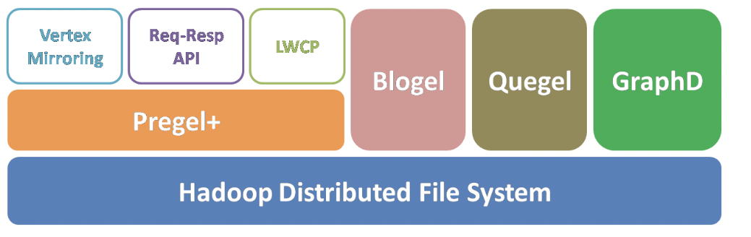
Think Like a Vertex (TLAV)
Our Pregel-Like Systems
Pregel+: techniques to reduce message numbers (PVLDB’14, WWW’15, ICDE’18, TCBB’19)
Blogel: graph partitioning + think like a partition (PVLDB’14)
Quegel: online query processing with interactive speed (PVLDB’16)
GraphD: distributed out-of-core execution (TPDS’18)
LWFT: faster checkpointing and recovery (ICPP’19)
Notes:
I have worked on Pregel-like systems by improving from various aspects including message reduction, graph partitioning, online querying, out-of-core execution, and fault tolerance.

Slide 8
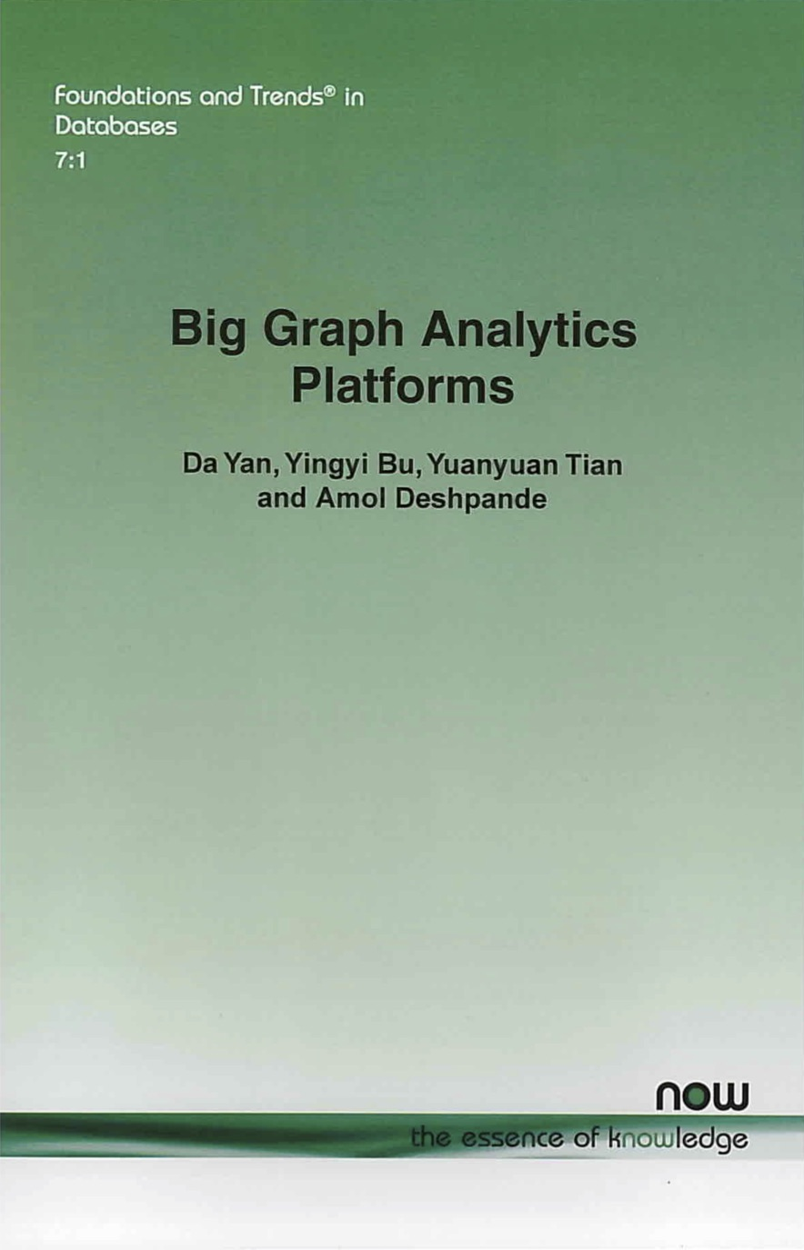
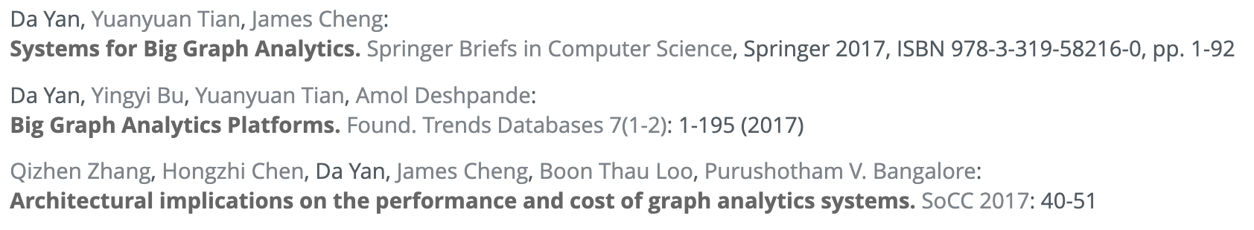
Our TLAV Research
Notes:
Here are my related publications as well as my book on TLAV graph systems.

Slide 9
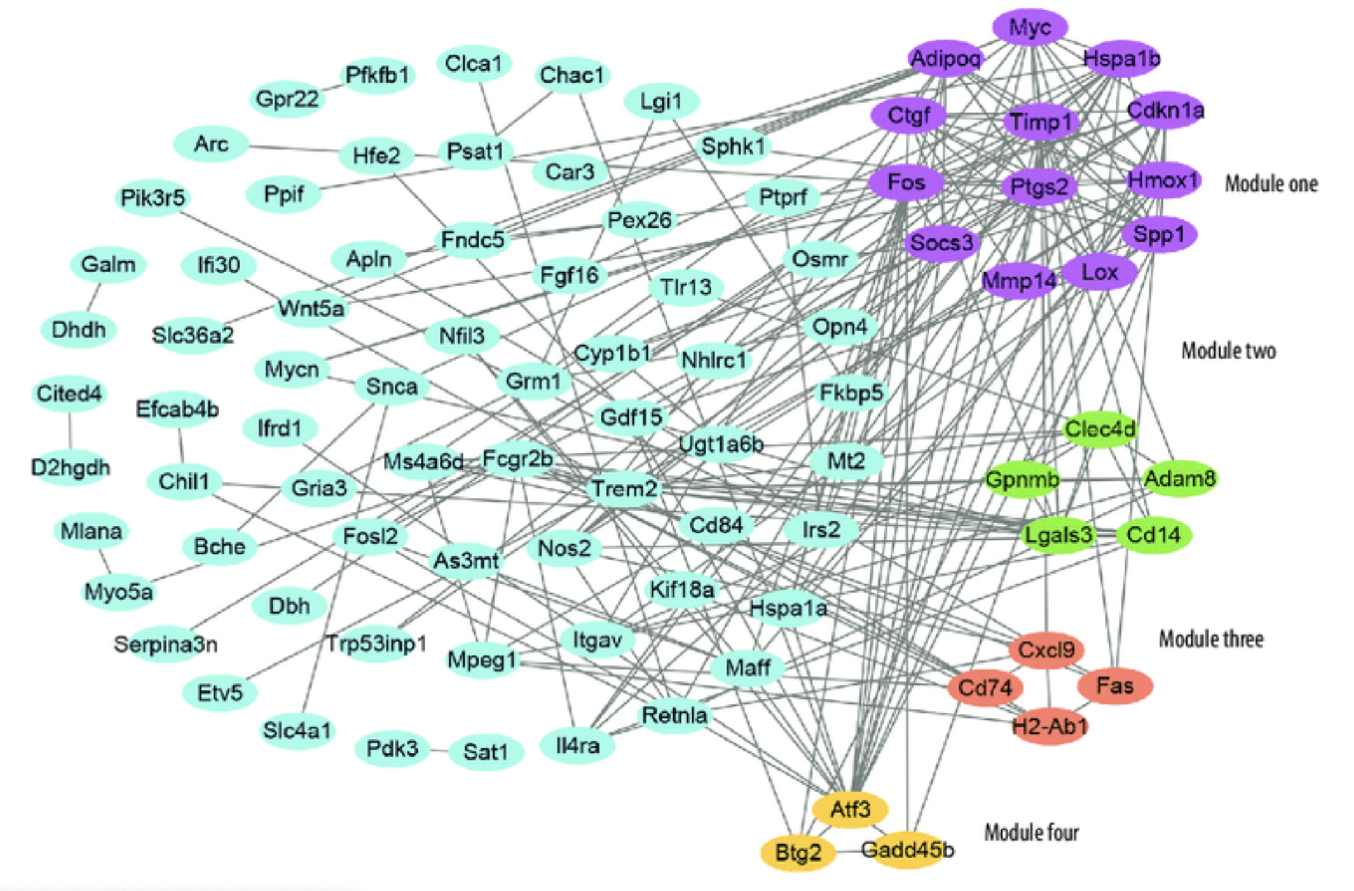
Is TLAV Sufficient?
Graph-Centric, Recursive
High time complexity
Often NP-hard due to search space explosion
Heavily relies on effective pruning techniques
Graph DB
Notes:
However, not all graph problems can be efficiently computed in parallel by the TLAV model, especially when we want to find subgraph structures with certain properties.
Their algorithms often have a very high time complexity, and their computation operates on subgraphs rather than individual vertices, so it is neither convenient nor efficient to solve them using the TLAV model.
In fact, their algorithms usually follow a backtracking process on a search space tree where each node corresponds to a set of vertices, so the search space can be as large as the power set of the vertex set.

Slide 10
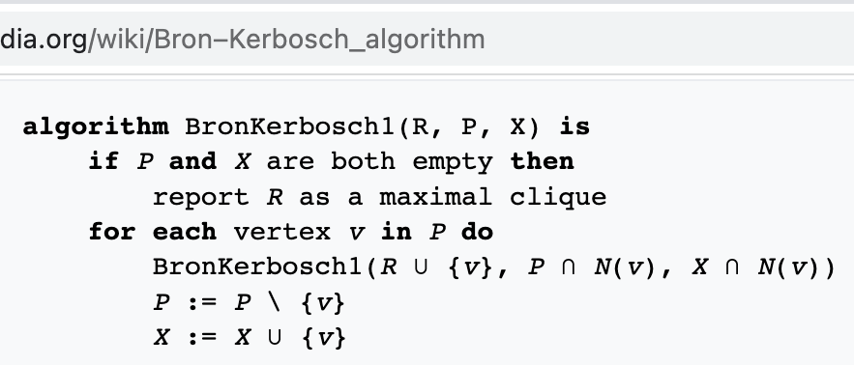
Is TLAV Sufficient?
Bron–Kerbosch Algorithm
{}
{a}
{b}
{c}
{d}
{a, b}
{a, c}
{a, d}
{b, c}
{b, d}
{c, d}
{a, b, c}
{a, b, d}
{a, c, d}
{b, c, d}
{a, b, c, d}
a < b < c < d
Set-enumeration tree
Also applicable to k-plexes, γ-quasi-cliques, etc.
Notes:
An example is the Bron-Kerbosch algorithm for mining maximal cliques, which recursively extends the current set of vertices that form a clique with one more candidate,
and this search process can be organized as a set-enumeration tree.
This enumeration approach also applies to the mining of other dense structures such as quasi-cliques and k-plexes.

Slide 11
Is TLAV Sufficient?
Bron–Kerbosch Algorithm
{}
R = {}, P = {abcd}, X = {}
Notes:
This recursive backtracking search begins with R, the current set of vertices, being empty, and it adds one vertex in candidate set P to R at a time.

Slide 12
Is TLAV Sufficient?
Bron–Kerbosch Algorithm
{}
{a}
R = {a}, P = {bcd}, X = {}
R = {}, P = {abcd}, X = {}
Notes:
a is first added from P to R

Slide 13
Is TLAV Sufficient?
Bron–Kerbosch Algorithm
{}
{a}
{a, b}
R = {ab}, P = {cd}, X = {}
R = {a}, P = {bcd}, X = {}
R = {}, P = {abcd}, X = {}
Notes:
Then, b from P to R

Slide 14
Is TLAV Sufficient?
Bron–Kerbosch Algorithm
{}
{a}
{a, b}
{a, b, c}
R = {abc}, P = {d}, X = {}
R = {ab}, P = {cd}, X = {}
R = {a}, P = {bcd}, X = {}
R = {}, P = {abcd}, X = {}
Notes:
and c from P to R

Slide 15
Is TLAV Sufficient?
Bron–Kerbosch Algorithm
{}
{a}
{a, b}
{a, b, c}
{a, b, c, d}
R = {abcd}, P = {}, X = {}
R = {abc}, P = {d}, X = {}
R = {ab}, P = {cd}, X = {}
R = {a}, P = {bcd}, X = {}
R = {}, P = {abcd}, X = {}
Notes:
and then, d is added from P to R

Slide 16
Is TLAV Sufficient?
Bron–Kerbosch Algorithm
{}
{a}
{a, b}
{a, b, c}
{a, b, c, d}
R = {abcd}, P = {}, X = {}
R = {abc}, P = {d}, X = {}
R = {ab}, P = {cd}, X = {}
Output: {abcd}
R = {a}, P = {bcd}, X = {}
R = {}, P = {abcd}, X = {}
Notes:
And at this time, since both P and X are empty, R is determined as a maximal clique and emitted.

Slide 17
Is TLAV Sufficient?
Bron–Kerbosch Algorithm
{}
{a}
{a, b}
{a, b, c}
{a, b, c, d}
R = {abc}, P = {}, X = {d}
R = {ab}, P = {cd}, X = {}
Output: {abcd}
R = {a}, P = {bcd}, X = {}
R = {}, P = {abcd}, X = {}
Notes:
It then backtracks to move d to the exclusion set X, which is used to avoid emitting non-maximal results.
Since there is no candidate in P to extend R, it then backtracks to node R equaling ab, where c is added to the exclusion set X
[next page]

Slide 18
Is TLAV Sufficient?
Bron–Kerbosch Algorithm
{}
{a}
{a, b}
{a, b, c}
{a, b, c, d}
R = {ab}, P = {d}, X = {c}
Output: {abcd}
R = {a}, P = {bcd}, X = {}
R = {}, P = {abcd}, X = {}
Notes:
and adds the next candidate d to R
[next page]

Slide 19
Is TLAV Sufficient?
Bron–Kerbosch Algorithm
{}
{a}
{a, b}
{a, b, c}
{a, b, d}
{a, b, c, d}
R = {abd}, P = {}, X = {c}
R = {ab}, P = {d}, X = {c}
Output: {abcd}
R = {a}, P = {bcd}, X = {}
R = {}, P = {abcd}, X = {}
Notes:
[next page]

Slide 20
Is TLAV Sufficient?
Bron–Kerbosch Algorithm
{}
{a}
{a, b}
{a, b, c}
{a, b, d}
{a, b, c, d}
R = {abd}, P = {}, X = {c}
R = {ab}, P = {d}, X = {c}
Output: {abcd}
R = {a}, P = {bcd}, X = {}
R = {}, P = {abcd}, X = {}
Notes:
Since c is in X, abd is not emitted as a maximal clique

Slide 21
Is TLAV Sufficient?
Bron–Kerbosch Algorithm
{}
{a}
{b}
{c}
{d}
{a, b}
{a, c}
{a, d}
{b, c}
{b, d}
{c, d}
{a, b, c}
{a, b, d}
{a, c, d}
{b, c, d}
{a, b, c, d}
a < b < c < d
Set-enumeration tree
Also applicable to k-plexes, γ-quasi-cliques, etc.
Notes:
This recursive process goes on until the entire set-enumeration tree is traversed.

Slide 22
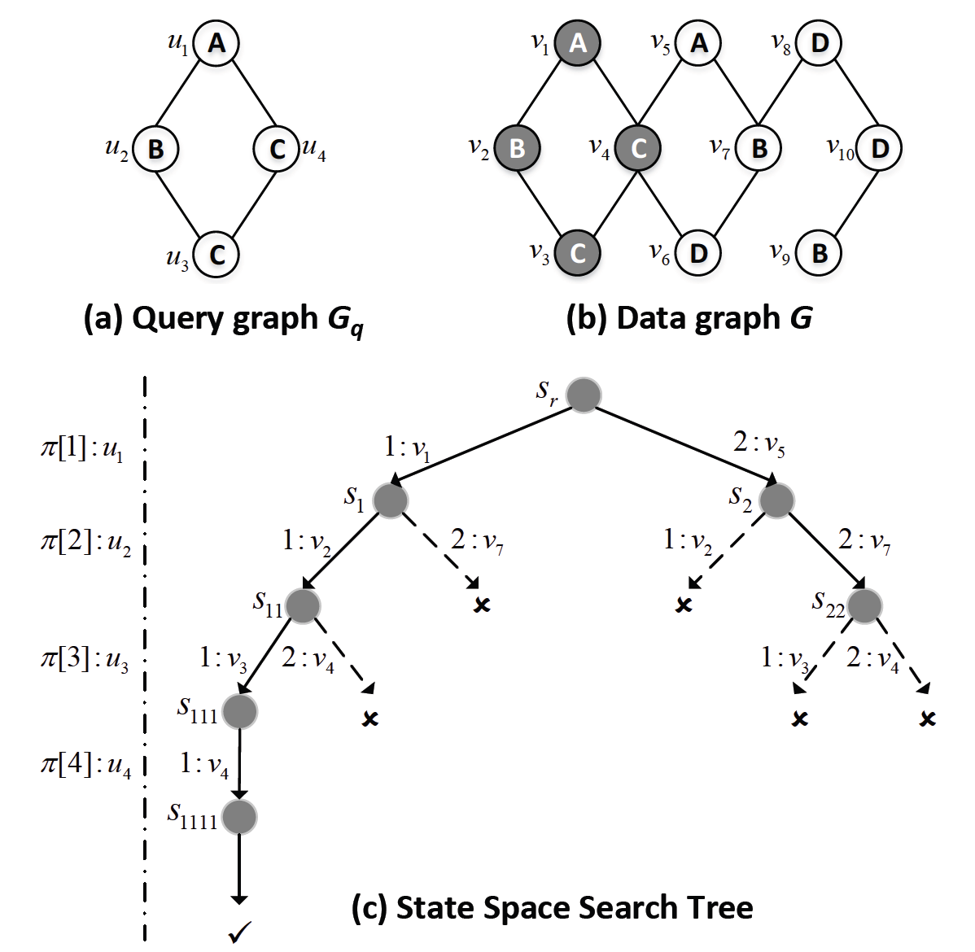
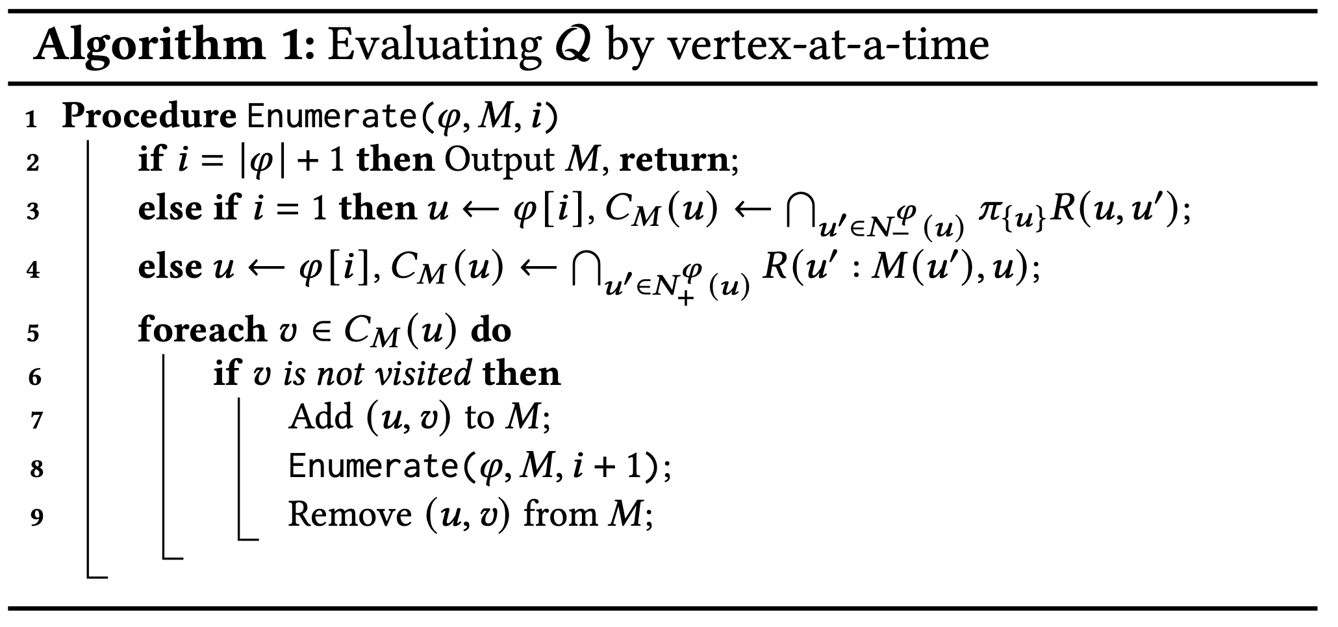
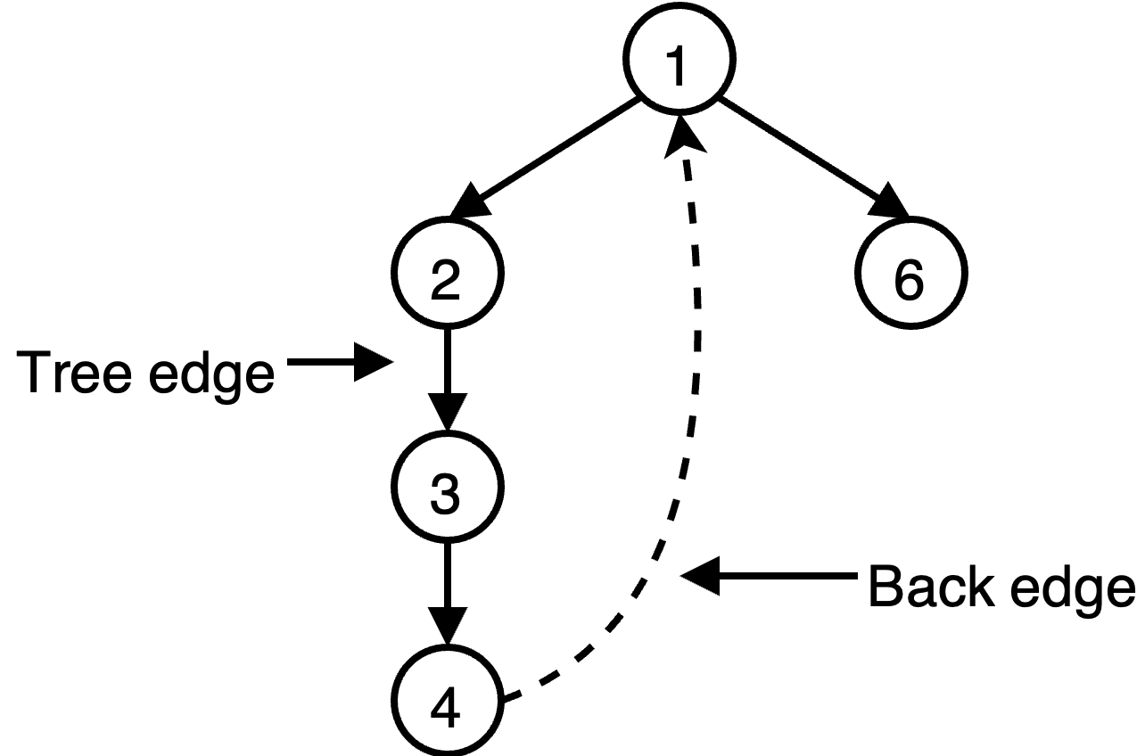
Is TLAV Sufficient?
Ullmann’s Algorithm
Notes:
As a second example, we consider Ullmann’s algorithm for subgraph matching, which finds all subgraphs in a data graph that match a given query graph.
The algorithm recursively extends the current set of "vertex matches" with one more query vertex to match, and this search process can be organized as a state-space tree.

Slide 23
Is TLAV Sufficient?
Ullmann’s Algorithm
M =
<u₁, v₁>
Notes:
First, query vertex u1 is matched to data vertex v1

Slide 24
Is TLAV Sufficient?
Ullmann’s Algorithm
M =
<u₂, v₂>
<u₁, v₁>
Notes:
Then, query vertex u2 is matched to data vertex v2

Slide 25
Is TLAV Sufficient?
Ullmann’s Algorithm
<u₃, v₃>
M =
<u₂, v₂>
<u₁, v₁>
Notes:
Then, u3 to v3

Slide 26
Is TLAV Sufficient?
Ullmann’s Algorithm
<u₄, v₄>
<u₃, v₃>
M =
<u₂, v₂>
<u₁, v₁>
Notes:
and u4 to v4

Slide 27
Is TLAV Sufficient?
Ullmann’s Algorithm
<u₄, v₄>
<u₃, v₃>
M =
<u₂, v₂>
Output: {v₁ v₂ v₃ v₄}
<u₁, v₁>
Notes:
At this time, a match is found so it is emitted

Slide 28
Is TLAV Sufficient?
Ullmann’s Algorithm
<u₃, v₄>
x
M =
<u₂, v₂>
Output: {v₁ v₂ v₃ v₄}
<u₁, v₁>
Notes:
The search then backtracks to match the next candidate vertex v4 to query vertex u3, but the blue query edge BC is missing, so this match fails and stops its extension.
This recursive process goes on until all matches in the data graph are found.

Slide 29
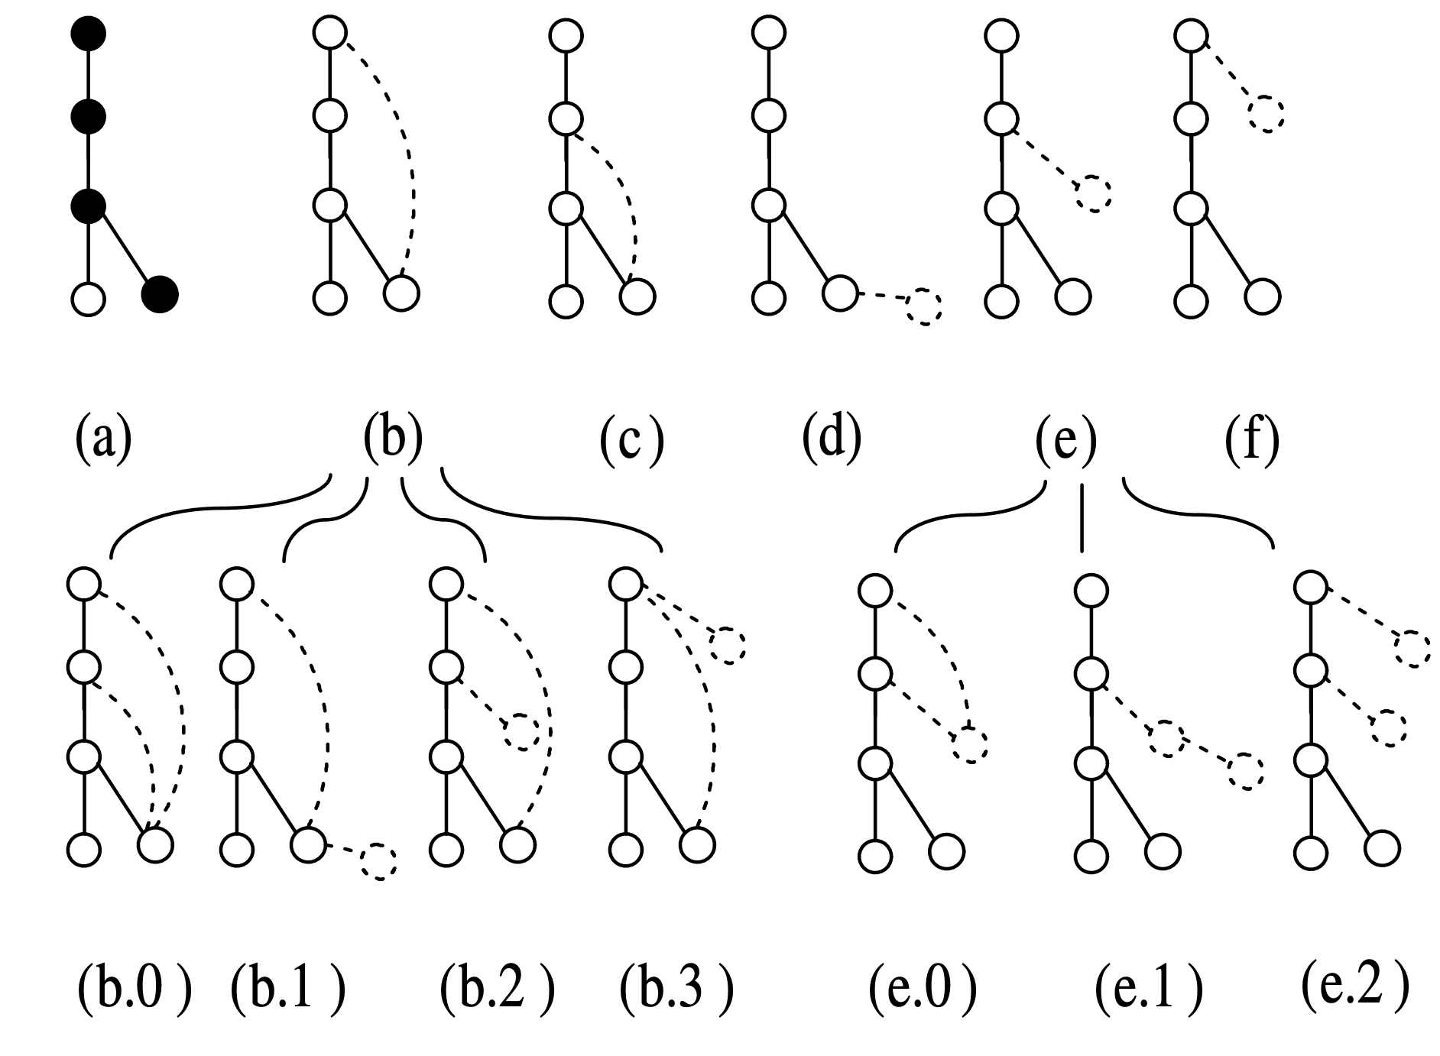
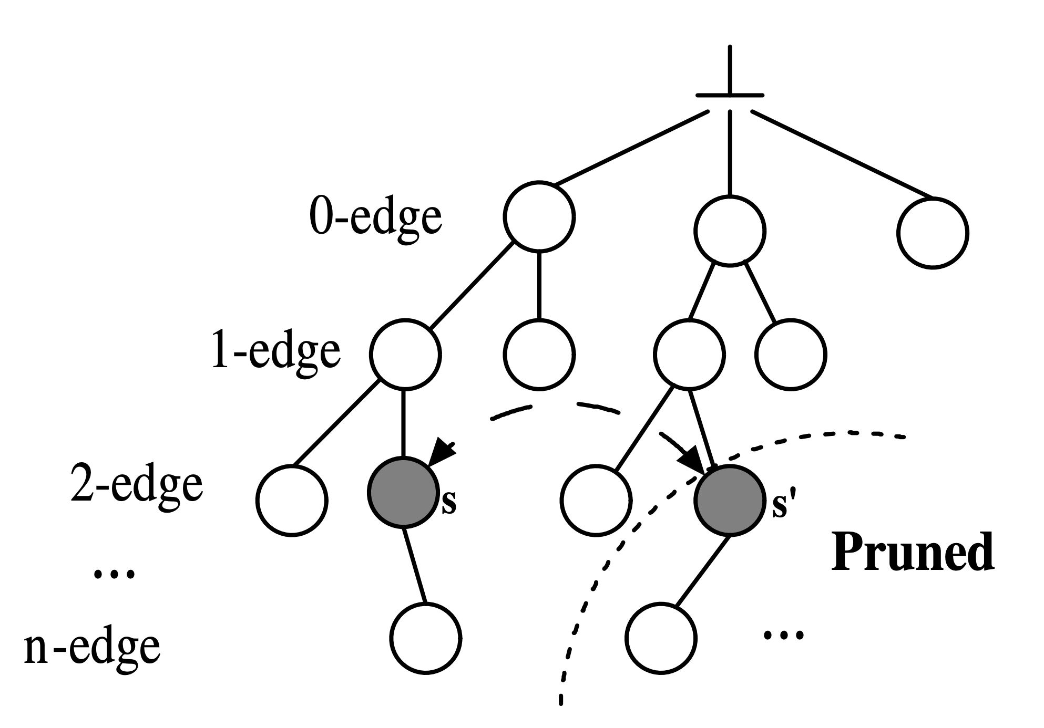
Is TLAV Sufficient?
gSpan/GraMi
Rightmost Path Extension
Notes:
A last example is the depth-first subgraph pattern generation for the application of frequent subgraph pattern mining.
The pattern graph growing process can also be organized as a search tree.

Slide 30
Is TLAV Sufficient?
4 edges
5 edges
gSpan/GraMi
Rightmost Path Extension
Notes:
Following gspan’s rightmost path extension strategy, this slide shows how a 4-edge pattern can generate patterns with 5 edges.

Slide 31
Is TLAV Sufficient?
5 edges
6 edges
gSpan/GraMi
Rightmost Path Extension
Notes:
This slide shows how a 5-edge pattern can generate patterns with 6 edges.

Slide 32
Is TLAV Sufficient?
5 edges
6 edges
gSpan/GraMi
Rightmost Path Extension
Notes:
This slide shows how another 5-edge pattern can generate patterns with 6 edges.

Slide 33
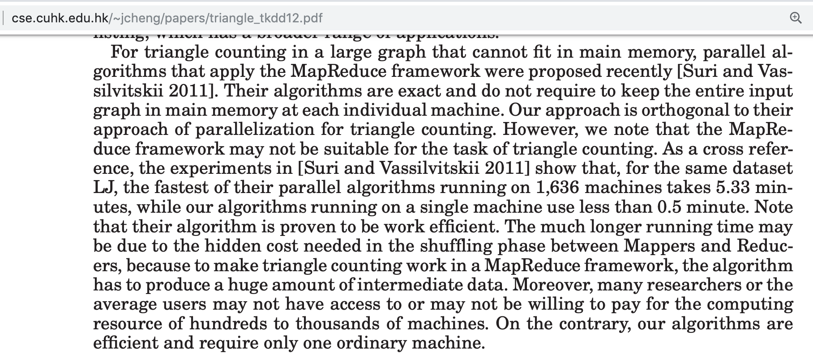
Is TLAV Sufficient?
Notes:
There are works applying vertex-centric programs simulated by MapReduce or Pregel-like systems for structure analytics, but the performance is terrible.
For example,
[click]
a TKDD paper on "serial external-memory triangle counting" finds that their program is 10 times faster than a state-of-the-art MapReduce algorithm, even though the MapReduce algorithm uses more than 16 hundred machines.
This is mainly due to the cost of materializing and transmitting the intermediate results.
[click]
Frank McSherry also noticed that existing Big Data frameworks can scale with the data size by adding more machines and hence memories, but the computing performance is not much faster than a single-threaded external-memory program running on the SSD of a laptop.
[click]
He further indicate that the systems community as represented by OSDI and SOSP was overexcited about, but not very good at, Big Graph computation.
[click]
So, in the domain of subgraph structure analysis, we need a new computing model that can fully utilize the CPU cores by avoiding unnecessary IO cost incurred by materializing and transmitting the intermediate results.

Slide 34
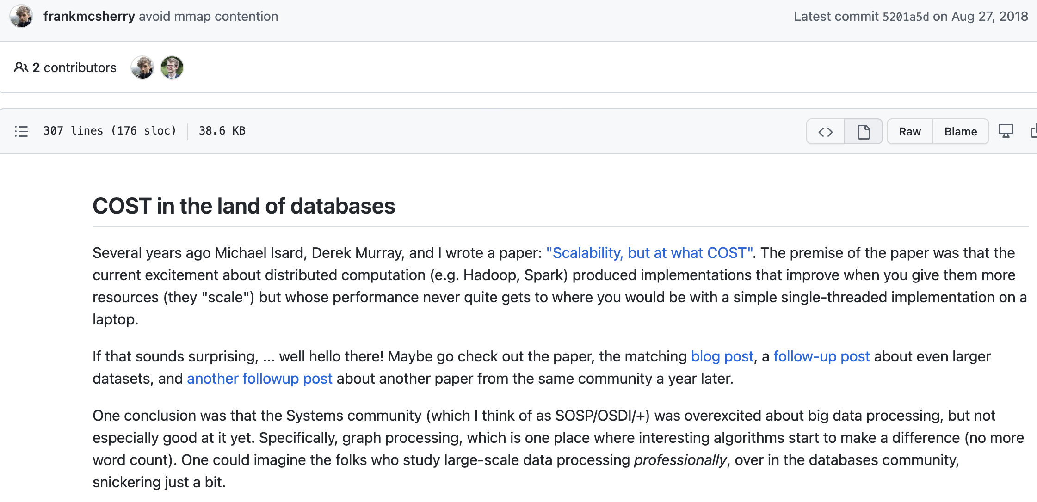
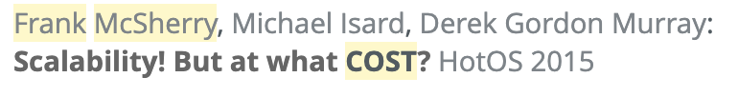
Is TLAV Sufficient?
New model for graph systems research?
Notes:
There are works applying vertex-centric programs simulated by MapReduce or Pregel-like systems for structure analytics, but the performance is terrible.
For example,
[click]
a TKDD paper on "serial external-memory triangle counting" finds that their program is 10 times faster than a state-of-the-art MapReduce algorithm, even though the MapReduce algorithm uses more than 16 hundred machines.
This is mainly due to the cost of materializing and transmitting the intermediate results.
[click]
Frank McSherry also noticed that existing Big Data frameworks can scale with the data size by adding more machines and hence memories, but the computing performance is not much faster than a single-threaded external-memory program running on the SSD of a laptop.
[click]
He further indicate that the systems community as represented by OSDI and SOSP was overexcited about, but not very good at, Big Graph computation.
[click]
So, in the domain of subgraph structure analysis, we need a new computing model that can fully utilize the CPU cores by avoiding unnecessary IO cost incurred by materializing and transmitting the intermediate results.

Slide 35
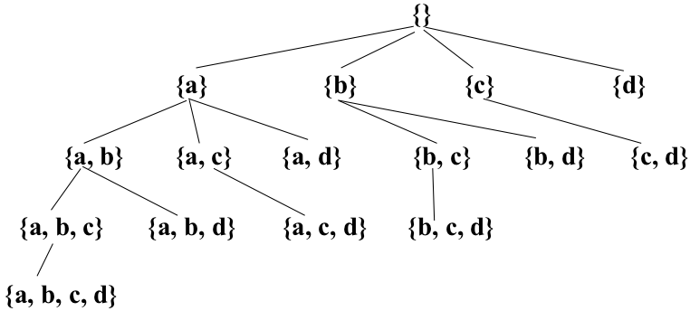
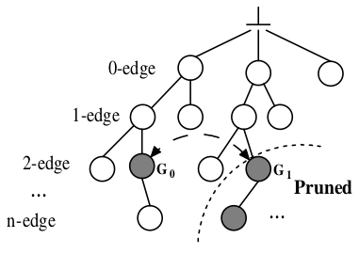
Existing Solutions
Programming Simplicity Over-Emphasized
Dense Subgraph Mining
Frequent Subgraph Mining
pattern-to-instance
instance-to-pattern
Embedding-Centric: Arabesque (SOSP’15), RStream (OSDI’18)
BFS: Layer-wise Subgraph Materialization!
Notes:
Unfortunately, before T-thinker, prior solutions are IO-bound and materialize the subgraphs level-by-level in a search tree, causing a lot of intermediate subgraphs being materialized
which not only hurts performance but also limits the size of the graph that can be processed.
Surprisingly, these works were accepted by the best systems conferences such as OSDI and SOSP.

Slide 36
Structure Analytics
Da Yan yanda@iu.edu
Notes:
Good morning everyone! Welcome to our tutorial titled “Systems for Scalable Graph Analytics and Machine Learning: Trends and Methods”.
This tutorial is contributed by two groups from Indiana University Bloomington and the Chinese University of Hong Kong.
My name is Lyuheng Yuan from Indiana University Bloomington.
This tutorial is supposed to be delivered by 2 or 3 people, since it's a 3-hr tutorial. But unfortunately, there's some visa issues with the other authors, so I will be presenting all the materials in this long tutorial.
So hopefully you will enjoy this tutorial and don't get bored with the material.

Slide 37
Structure Analysis
Part I: Think Like a Task (TLAT) Model, and TLAT Systems
Subgraph matching
Dense subgraph mining
Frequent subgraph pattern mining
Part II: Subgraph Querying & Mining on GPUs
Case study: systems for subgraph matching/enumeration
Notes:
A real graph analytics pipeline often involves a combination of three types of graph operations, often including vertex analytics, structure analytics, and graph machine learning.
If you look at this figure, where you're given an input graph. You can first ...
[CLICK]
This tutorial focuses on the system design perspective of these graph operations. In other words, we will look at the problem mostly from efficiency perspective. I know in most AI problem, people cares about accuracy, such as precision/recall/F1-score these metrics. But in this tutorial, we will care more about the efficiency, or in other words, do we have faster methods to solve the same problem?
So the most works we mention and discussed will be from DB and HPC conferences.

Slide 38
Part I: Think Like a Task (TLAT) Model, and TLAT Systems
Structure Analytics
Da Yan yanda@iu.edu
Notes:
Good morning everyone! Welcome to our tutorial titled “Systems for Scalable Graph Analytics and Machine Learning: Trends and Methods”.
This tutorial is contributed by two groups from Indiana University Bloomington and the Chinese University of Hong Kong.
My name is Lyuheng Yuan from Indiana University Bloomington.
This tutorial is supposed to be delivered by 2 or 3 people, since it's a 3-hr tutorial. But unfortunately, there's some visa issues with the other authors, so I will be presenting all the materials in this long tutorial.
So hopefully you will enjoy this tutorial and don't get bored with the material.

Slide 39

Notes:
In 2018, realizing these issues, I proposed the framework of T-thinker, which effectively utilizes the CPU cores in a cluster by properly dividing a problem over a big dataset into tasks over smaller subsets of the dataset.

Slide 40
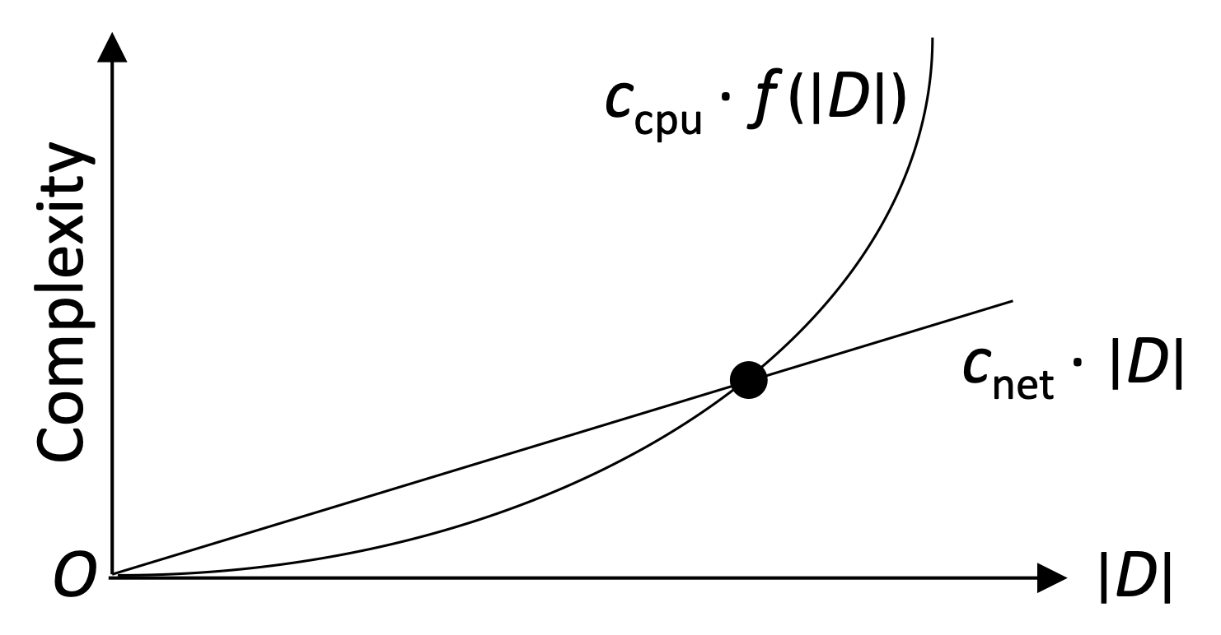
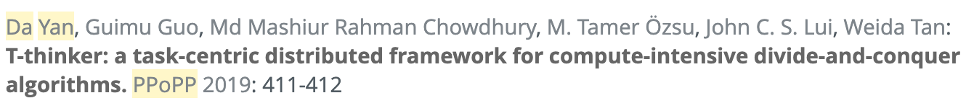
Think Like a Task (T-Thinker)
Divide and Conquer
Think Like a Task
Data pulling + computation on top
Notes:
Since the problems we target has a high time complexity, as long as each task handles sufficient data, the IO cost of pulling the data into memory by a thread is linear while the computation on top is super-linear, so the communication can be fully overlapped with computation to keep CPUs busy in a cluster.

Slide 41
Think Like a Task (T-Thinker)
Tasks & Programming Model
Notes:
The first kind of graph problems are vertex-centric, such as random walk algorithms like PageRank, and machine learning algorithms like belief propagation.
We can see that those problems often have a linear-sized output, typically one score for each vertex or each edge.

Slide 42
G-thinker
Vertex Pulling & Remote Vertex Caching
Tasks can share vertices to reduce # of remote vertex requests
8
6 | 7
0
1 | 3
6
5 | 8
5
4 | 6
8
6 | 7
0
1 | 3
1
0 | 2 | 3
2
1 | 3 | 4 | 7
3
0 | 1 | 2 | 7
4
2 | 5 | 7
5
4 | 6
6
5 | 8
7
2 | 3 | 4 | 8
8
6 | 7
M₀
M₁
M₂
Notes:
The first T-thinker-based system I developed is G-thinker, a distributed system for finding qualified subgraph instances in a big graph, such as subgraph matching and dense subgraph mining.
G-thinker keeps the adjacency lists with a distributed key-value store.
Each machine also maintains a vertex cache to cache remote vertices
so that multiple local tasks can access them without repeated requesting.

Slide 43

G-thinker
Task-Centric Programming Interface
UDF: spawn_task(vertex)
UDF: compute(task, frontier)
pull(vertex_id)
add_task(task)
Task Metadata
Task Subgraph
* UDF = user-defined function
Notes:
The programming interface is shown on this slide, where initial tasks are spawned from individual vertices.
Each task computes in iterations, where the input argument "frontier" of a user-defined compute function keeps the adjacency lists of those vertices requested in the previous iteration, and one may call the pull function to request for new vertices.
Users can expand the subgraph of the current task in iterations until all the needed data are ready, after which the computation can happen on the subgraph.
To avoid straggler tasks, one may also decompose the current task into smaller tasks and call the add_task function to add them to the system for parallel computation.

Slide 44
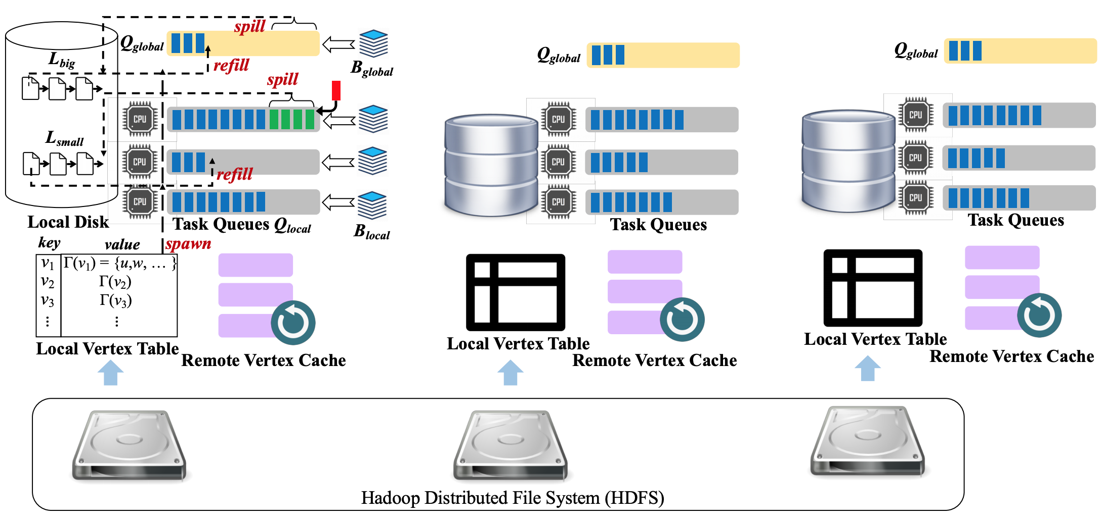
G-thinker
Notes:
Here is an overview of the G-thinker system with three machines.
Note that each machine has a yellow global task queue to hold big tasks that are time-consuming, and gray task queues local to each CPU core to hold regular tasks to avoid contention.
G-thinker keeps the memory consumption bounded by only working with a small window of active tasks at any time, and additional tasks generated due to task decomposition can be temporarily moved to the disk in batch, to be fetched and processed later when memory space permits.
New tasks are only spawned when there are not sufficient active tasks.

Slide 45
G-thinker
small task
big task
Head-of-line blocking
Task Queues
Task Queues
Notes:
Note that without a shared global task queue, if a local task queue holds many big tasks,
[click]
head-of-line blocking happens where a CPU core becomes the straggler while the other CPU cores finish quickly and become idle.

Slide 46
G-thinker
small task
big task
Work Stealing
Q_{global}
Q_{global}
Task Queues
Task Queues
Notes:
By putting all big tasks in the shared global task queue which also supports work stealing among the machines,
[click, wait for annotation to complete] [click]
the big tasks can be scheduled with priority among all available CPU cores for timely processing, or even be further decomposed to create more parallelism opportunities.

Slide 47
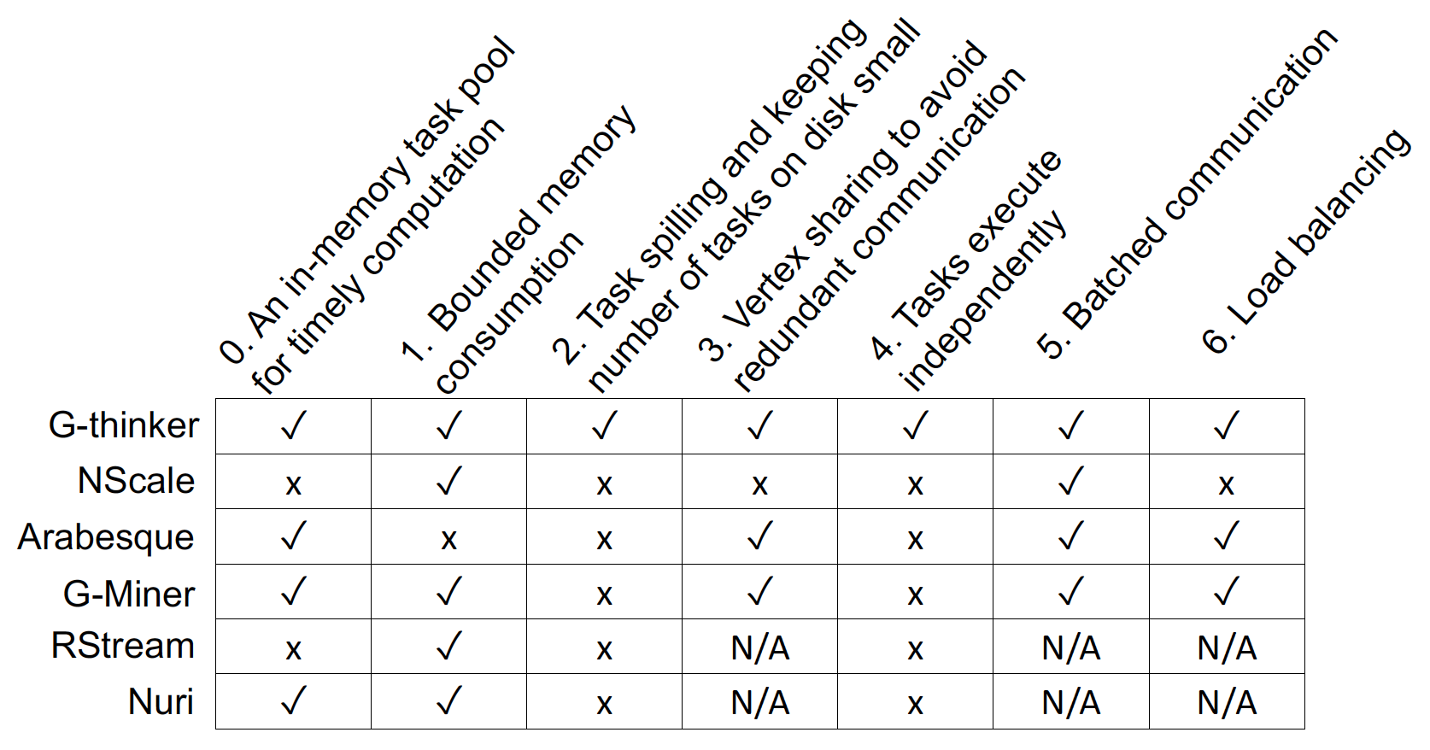
G-thinker
Friendster (|V| = 65.6 M, |E| = 1806 M)
Maximum Clique:
G-Miner: 10644 sec / 7.4 GB per machine
G-thinker: 252 sec / 3.4 GB per machine
Triangle Counting:
G-Miner: 10915 sec / 9.2 GB per machine
G-thinker: 516 sec / 3.1 GB per machine
Large Maximum Cliques
WikiLinks: |Q_{max}| = 1109 / 70 min 51 sec
WebUK: |Q_{max}| = 944 / 691 sec
Notes:
G-thinker is two orders of magnitude faster than existing systems, and can find very large maximum cliques with over 1000 vertices in a reasonable amount of time, for which other systems would run almost forever.

Slide 48
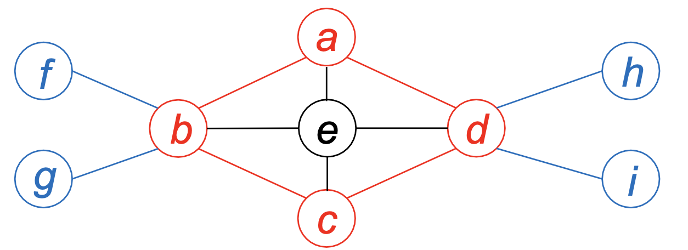
Quasi-Cliques on G-thinker
A graph G = (V, E) is a γ-quasi-clique (0 ≤ γ ≤ 1) if G is connected and for any v ∈ V , we have d(v) ≥ ⌈γ · (|V| − 1)⌉.
S₁ = {a, b, c, d}
S₂ = S₁ ∪ e
Both S₁ and S₂ are 2/3-quasi-cliques
Only S₂ is a maximal 2/3-quasi-clique
Notes:
We have tested many algorithms on G-thinker such as maximum clique finding, triangle counting and subgraph matching, all achieved ideal speedup with the number of CPU cores.
So, we moved on to tackle the more challenging problem of mining gamma-quasi-cliques, which previously has only been tested on very small graphs.
Put simply, a quasi-clique is a dense subgraph that relaxes the clique definition to allow each vertex to miss the connections to a certain fraction of the other vertices, and I will skip the introduction of its definition to save time.

Slide 49
Quasi-Cliques on G-thinker
S: set of nodes already in subgraph
ext(S): set of valid candidates to add
{}
{a}
{b}
{c}
{d}
{a, b}
{a, c}
{a, d}
{b, c}
{b, d}
{c, d}
Can be a straggler !
{a, b, c}
{a, b, d}
{a, c, d}
{b, c, d}
a < b < c < d
{a, b, c, d}
UDF: spawn_task(vertex)
Notes:
In G-thinker, [click] we can create initial tasks from individual vertices,
[click]
but these tasks can have very imbalanced workloads.

Slide 50
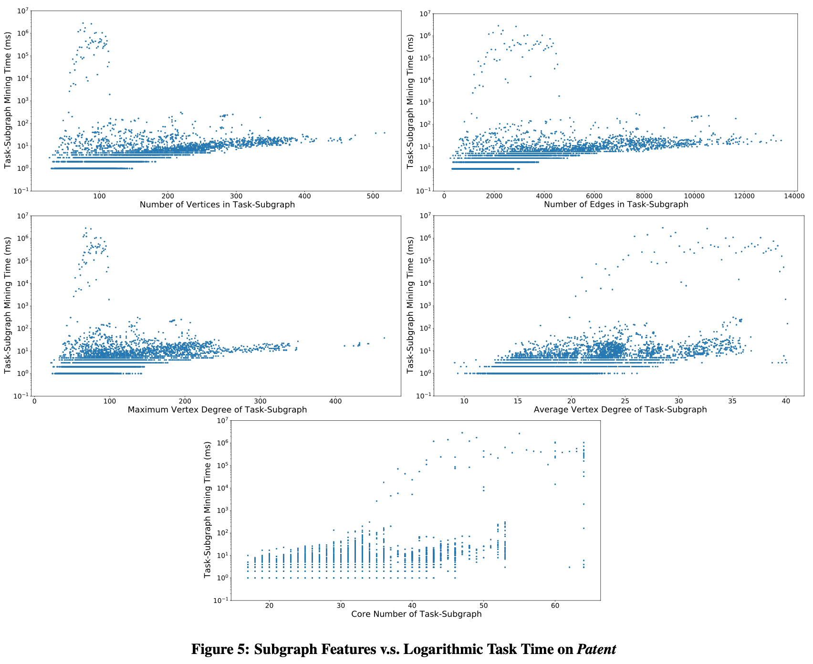
8 orders of magnitude
Why Such Huge Task Time Difference?
Notes:
Here we explored the task running time with respect to difference subgraph features such as the number of nodes and edges, and density measures such as average degree and core number, but we can see that even for small feature values, some subgraph tasks can be orders of magnitude more expensive than others, and we find that no machine learning model can identify these expensive big tasks effectively.
[click]
Why is there such a huge time difference among the tasks?

Slide 51
Quasi-Cliques on G-thinker
Heavily relies on pruning rules to be tractable
Graph-Diameter Based Pruning
Size-Threshold Based Pruning
Degree-Based Pruning
Upper- and Lower-Bound Based Pruning
Critical-Vertex Based Pruning
Cover-Vertex Based Pruning
Notes:
This is because the quasi-clique mining algorithm relies on many pruning rules to significantly reduce the search space, but these rules depend on the complicated connection relationships among the current set of vertices under exploration, and the timing when a pruning rule is applicable is difficult to predict.

Slide 52
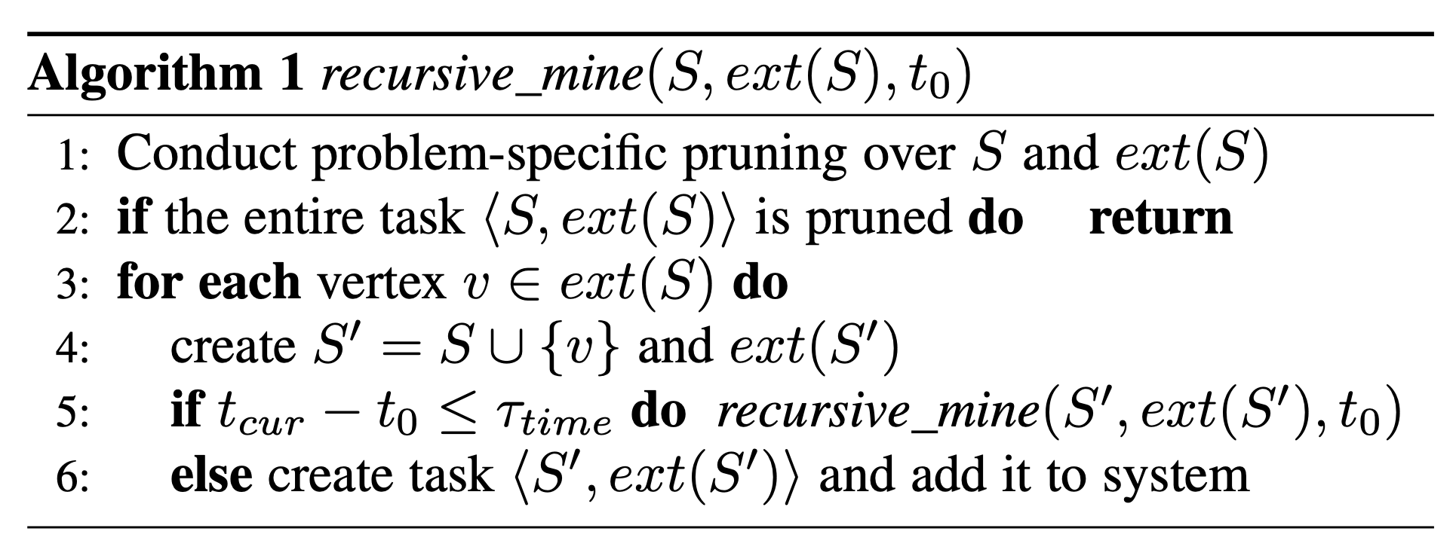
Quasi-Cliques on G-thinker
Timeout Mechanism for Task Decomposition
t₀ = 0
{a}
Q_{global}
t₁
{a, b}
t₂
{a, b, c}
t₃
{a, b, c, d}
Notes:
We therefore propose a timeout mechanism, where a task runs the recursive algorithm to traverse the search space tree in depth-first order,

Slide 53
Quasi-Cliques on G-thinker
Timeout Mechanism for Task Decomposition
When {a, c} computes, it may timeout and decompose again
t₀ = 0
{a}
Q_{global}
t₁
t₅ > τ_{time}
t₆ > τ_{time}
X
{a, b}
{a, c}
{a, d}
t₂
t₄ > τ_{time}
{a, b, c}
{a, b, d}
{a, c, d}
t₃
{a, b, c, d}
Notes:
but if the task runs for too long and beyond a timeout threshold, we let the task create new subtasks to be added to the system rather than to recursively process the search space by itself.
For example, the task spawned by {a} traverses the search space tree and right before it processes abd, it finds that the time t4 times out, so abd becomes an independent task added to the system, and when the recursive algorithm backtracks, t5 and t6 also time out so ac and ad are also created as new tasks.
[click, let animation to finish] Smaller tasks will be added to the local queue, while big tasks such as those with many candidate vertices to expand will be added to the global queue,
[click]
and it may timeout again and be further decomposed later.
This way, straggler tasks are effectively eliminated to allow effective load balancing.

Slide 54
Quasi-Cliques on G-thinker
Mining Large Quasi-Cliques by Kernel Expansion
Mine γ’-quasi-cliques (γ’ > γ)
Select the k’ largest γ’-quasi-cliques as “kernels”
S₁
S₂
S₃
S₄
… …
Notes:
Mining all the maximal quasi-cliques for a small value of gamma can be prohibitively expensive, so a natural idea is to only find the large ones that are statistically more significant.
For this purpose, we can first mine gamma’-quasi-cliques where gamma’ is larger than gamma so that the result subgraphs are denser and the number of results is smaller.
[click]
We then select the top-k’ largest gamma’-quasi-cliques as kernels to expand them into larger gamma-quasi-cliques

Slide 55
Quasi-Cliques on G-thinker
Mining Large Quasi-Cliques by Kernel Expansion
Mine γ’-quasi-cliques (γ’ > γ)
Select the k’ largest γ’-quasi-cliques as “kernels”
For each kernel S, expand S into γ-quasi-cliques that are maximal locally in G(S ∪ ext(S))
For all the γ-quasi-clique found, return top-k large ones
S₁
S₂
S₃
S₁
S₂
S₃
Notes:
Here we assume that we continue our set-enumeration search from the top-3 largest kernels S1 [click]
S2 [click] and S3 [click]
Note that different kernels may grow into the same vertex set [click], and the further expansion from that set becomes redundant.

Slide 56
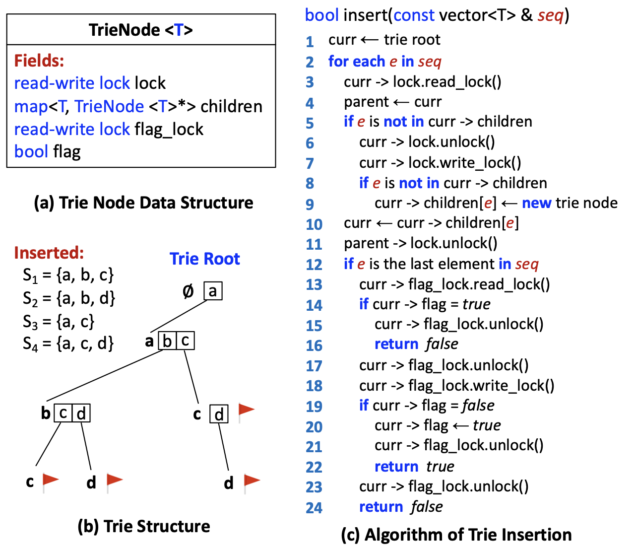
Quasi-Cliques on G-thinker
Redundancy Avoidance
S₁ = {a, c}
S₂ = {b, c}
{a, b, c}
a < c < b
b < c < a
Notes:
The issue is best illustrated here, where we extends S1=ac with b to obtain abc, [click] so b is considered to be after a in expansion
If we extend S2=bc with a to obtain abc, we are assuming a to be after b, which conflicts with the previous order.
To remove redundancy, we need a unified vertex order for expansion, so our solution is to let each kernel insert its traversed vertex set into a concurrent trie which implements a unique vertex ordering, so that when the same vertex set is traversed again from another kernel [click]
the redundant search stops at the node without further expansion.

Slide 57
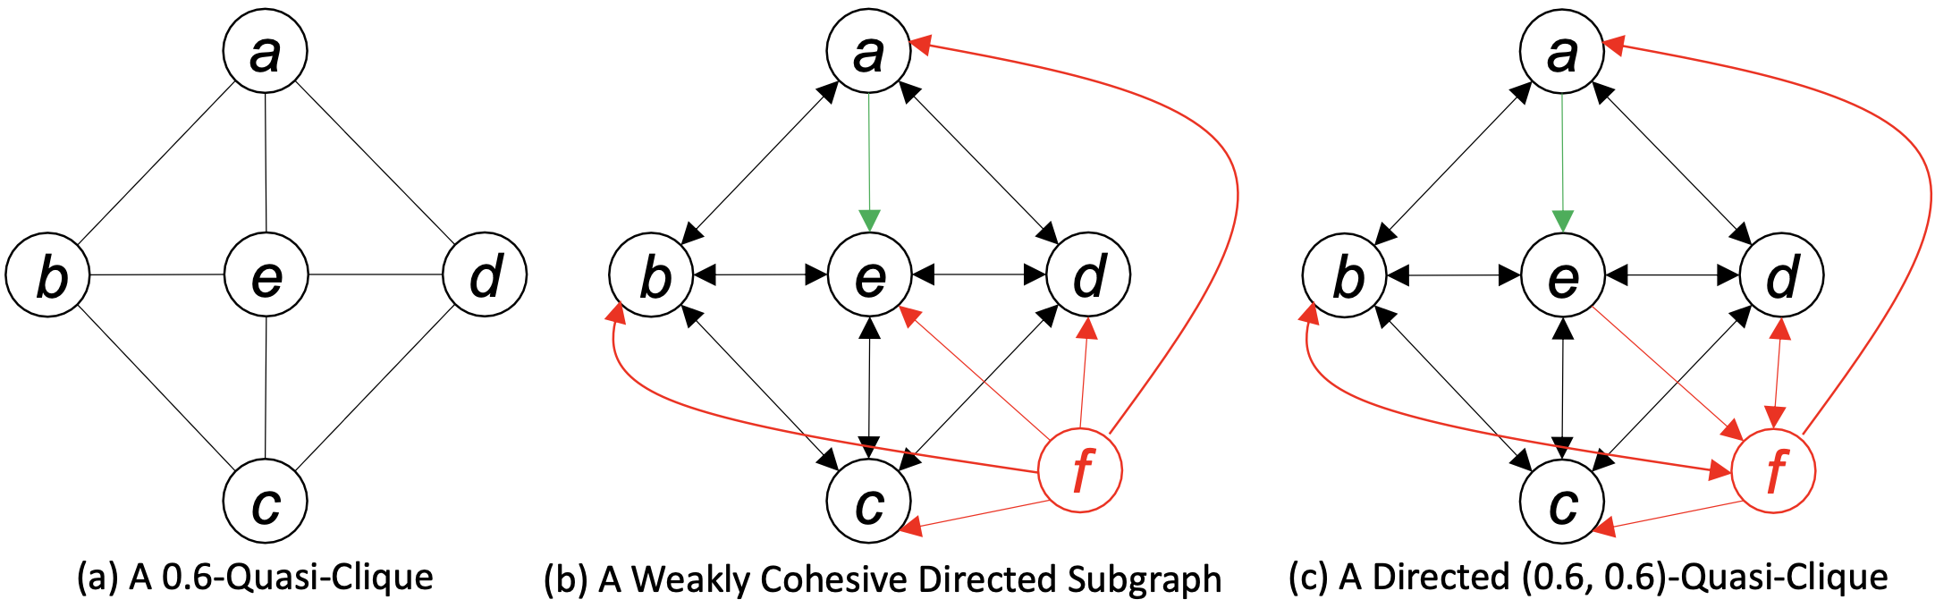
Directed Quasi-Cliques
A graph G = (V, E) is a (γ₁, γ₂)-quasi-clique (0 ≤ γ₁, γ₂ ≤ 1) if G is connected and for any v ∈ V , we have d_{in}(v) ≥ ⌈ γ₁ · (|V| − 1)⌉ and d_{out}(v) ≥ ⌈ γ₂ · (|V| − 1)⌉.
Notes:
Since quasi-cliques are clique generalizations, they are also only defined on undirected graphs, which limit their applicability.
We extended its definition to directed graphs, where we add density requirement on both indegree and outdegree, giving the concept of gamma1,gamma2-quasi-clique.
To see the need to consider both directions, consider the example in the middle, where a user f follows abcde on Twitter. This does not make f to be a valid new member of the quasi-clique community, since no other user follows f. In contrast, the example on the right is a valid directed quasi-clique since 3 out of the other 5 members also follow f.

Slide 58
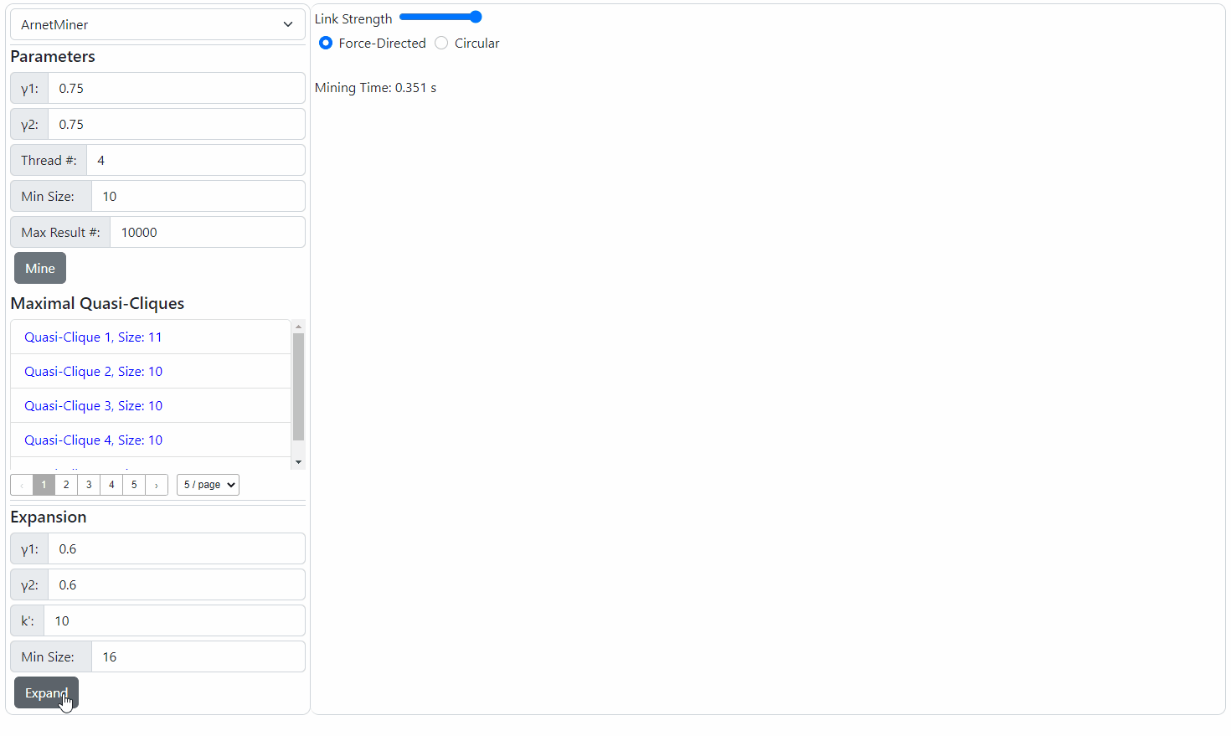
Directed Quasi-Cliques
New Pruning Opportunities beyond straightforward extension
Notes:
Considering both directions enables new pruning rules that are beyond simple generalization of pruning methods from undirected quasi-cliques.
We recently worked out a demo paper currently under submission to SIGMOD 2023, and here you can see a short video illustrating the cliques found from an author-citation graph.

Slide 59
G-thinkerQ: Online Querying
Features:
TLAT Programming Interface: the same as in G-thinker
For applications where query contents differ (e.g., subgraph matching, s-t path enumeration)
Concurrency + Fairness: tasks of a later-submitted query is processed only if tasks of earlier-submitted queries cannot saturate the available CPU cores
Task Lineage-Based Query Progress Tracking: to keep track of when the last task of a query finishes, so as to return query results in time and to release resources.
Lyuheng Yuan, Guimu Guo, Da Yan, Saugat Adhikari, Jalal Khalil, Cheng Long, and Lei Zou:
G-thinkerQ: A General Subgraph Querying System with a Unified Task-Based Programming Model. TKDE 2025 (accepted).
Notes:
While G-thinker is for one-time offline subgraph finding, many applications need online querying.
[click]
For example, in subgraph matching, different users may pose different query graphs against a giant data graph to find the matches.
We propose G-thinkerQ for such workloads, where users can use the same subgraph-centric programming interface as in G-thinker to program their applications.
[click]
G-thinkerQ evaluates many queries together, but it ensures that the tasks of queries that are submitted earlier are scheduled for execution with priority.
[click]
It also tracks the task evaluation progress of each query, so that the query results are returned immediately after the query finishes evaluation.

Slide 60



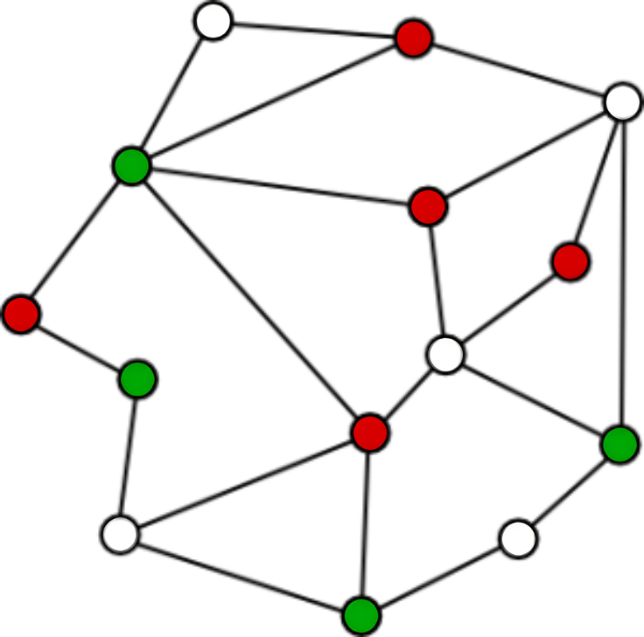
G-thinkerQ: Online Querying
task_prog
Comper<TaskT, QueryT>
queries
Internal Fields:
children_counter;
task_id;
parent_task_id;
query_id;
bool completed;
External Field:
output_file_stream fout;
Internal Fields:
comper_id;
current_task_id;
current_query_id;
UDFs:
bool to_query(const string& line, QueryT & q)
bool task_spawn(QueryT & q)
compute(ContextT & context, QueryT & q)
bool is_bigTask(ContextT & context)
bool postprocess(QueryT & q)
External Function:
add_task(TaskT* t)
Users
worker
Q_{wait}
task_spawn(.)
load and index graph
compers
head
tail
q₁
q₂
…
q_{k}
Task<ContextT>
…
Q_{active}
External Field:
ContextT context;
Internal Field:
task_prog* prog;
compute(.)
timeout
queries
tasks
tasks to spill
Worker<ComperT>
by comper
by worker
External Function:
run()
Lyuheng Yuan, Guimu Guo, Da Yan, Saugat Adhikari, Jalal Khalil, Cheng Long, and Lei Zou:
G-thinkerQ: A General Subgraph Querying System with a Unified Task-Based Programming Model. TKDE 2025 (accepted).
Notes:
In G-thinkerQ, users submit their queries into a task queue, but only a fixed number of active queries are fetched for evaluation at any time.
Each active query keeps its tasks in a task capsule, and each computing thread scans the capsules to obtain a task from the first available capsule.
If it fails to obtain a task after scanning to the tail,
and the number of active queries is smaller than our capacity threshold, a new query can be fetched from the queue for evaluation with a new capsule created.

Slide 61
G-thinkerQ: Online Querying
task_prog
Comper<TaskT, QueryT>
Internal Fields:
children_counter;
task_id;
parent_task_id;
query_id;
bool completed;
External Field:
output_file_stream fout;
Internal Fields:
comper_id;
current_task_id;
current_query_id;
UDFs:
bool to_query(const string& line, QueryT & q)
bool task_spawn(QueryT & q)
compute(ContextT & context, QueryT & q)
bool is_bigTask(ContextT & context)
bool postprocess(QueryT & q)
External Function:
add_task(TaskT* t)
Task Capsule
C_{big} = 16
head
tail
Q_{big}
q₂
q_{k}
q₁
…
L_{big}
…
refill
_{min}
Task<ContextT>
_{file}
τ_{big} = 8
n_{big} = 4
Q_{active}
External Field:
ContextT context;
Internal Field:
task_prog* prog;
C_{reg} = 512
spill
Q_{reg}
L_{reg}
…
_{min}
Worker<ComperT>
_{file}
τ_{reg} = 128
n_{reg} = 32
External Function:
run()
Lyuheng Yuan, Guimu Guo, Da Yan, Saugat Adhikari, Jalal Khalil, Cheng Long, and Lei Zou:
G-thinkerQ: A General Subgraph Querying System with a Unified Task-Based Programming Model. TKDE 2025 (accepted).
Notes:
Like in G-thinker, we keep the memory consumption of each capsule bounded, so that if the task queue of a query overflows, a block of tasks from the tail would be flushed to the disk, which will be refilled back when the task queue has space again.

Slide 62
G-thinkerQ: Online Querying
QueryT
task_prog
Comper<TaskT, QueryT>
Internal Fields:
children_counter;
task_id;
parent_task_id;
query_id;
bool completed;
External Field:
output_file_stream fout;
Internal Fields:
comper_id;
current_task_id;
current_query_id;
UDFs:
bool to_query(const string& line, QueryT & q)
bool task_spawn(QueryT & q)
compute(ContextT & context, QueryT & q)
bool is_bigTask(ContextT & context)
bool postprocess(QueryT & q)
External Function:
add_task(TaskT* t)
Task<ContextT>
External Field:
ContextT context;
Internal Field:
task_prog* prog;
Worker<ComperT>
External Function:
run()
Start a new phase?
Lyuheng Yuan, Guimu Guo, Da Yan, Saugat Adhikari, Jalal Khalil, Cheng Long, and Lei Zou:
G-thinkerQ: A General Subgraph Querying System with a Unified Task-Based Programming Model. TKDE 2025 (accepted).
Notes:
The programming interface now also takes a data type for the user query, such as the query graph in subgraph matching.
It has a user-defined function to convert a line of user's input string into a query object, which is then used to spawn the query's root task, as well as for later computation.
We also support postprocessing where users may start a new phase of query evaluation for this query, which is convenient in some applications.

Slide 63
G-thinkerQ
Task Status
Initiated
Child Task 2
Added
Child Task 2 Finished
Garbage Collection;
Notify Parent Task
Task Complete
0
1
2
3
2
1
0
Child Task 1 Added
Child Task 3 Added
Child Task 1 Finished
Child Task 3 Finished
task_prog
Comper<TaskT, QueryT>
Task ID | Task Progress Object
1
… | …
99
100
Internal Fields:
children_counter;
task_id;
parent_task_id;
query_id;
bool completed;
External Field:
output_file_stream fout;
Internal Fields:
comper_id;
current_task_id;
current_query_id;
UDFs:
bool to_query(const string& line, QueryT & q)
bool task_spawn(QueryT & q)
compute(ContextT & context, QueryT & q)
bool is_bigTask(ContextT & context)
bool postprocess(QueryT & q)
External Function:
add_task(TaskT* t)
Negligible Space Cost
Task<ContextT>
Task counter
External Field:
ContextT context;
Internal Field:
task_prog* prog;
Task ID
Parent Task ID
Query ID
Task Object is released upon finish;
Task Progress Object is released only after all child tasks finish;
Query finishes when Root Task finishes
Worker<ComperT>
External Function:
run()
Lyuheng Yuan, Guimu Guo, Da Yan, Saugat Adhikari, Jalal Khalil, Cheng Long, and Lei Zou:
G-thinkerQ: A General Subgraph Querying System with a Unified Task-Based Programming Model. TKDE 2025 (accepted).
Notes:
Transparent to the users, each task is also associated with a lightweight task progress object, which is created together with the task object.
Recall that a task may timeout and create many child tasks.
Unlike a task object which is released once it finishes evaluation, the lightweight task progress object is inserted in a table and kept alive to allow its child tasks to obtain it.
In this way, the task progress object maintains a counter of created child tasks, and when the last child task finishes evaluation and decrements the counter to zero, then it will finally release this task progress object.
It will also recursively notify the parent task's progress object to decrement its counter, and if the root task's counter is decremented to zero, the query finishes evaluation
so G-thinkerQ will report its results to the user.

Slide 64
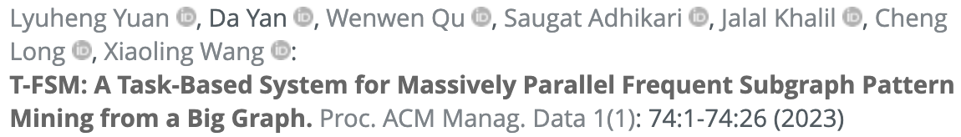
T-FSM
Frequent Subgraph Patterns from a Big Graph
Frequency is not anti-monotonic
S₁
u₁
G₁
v₂
A
B
count = 1
v₁
A
S₂
u₁
A
B
u₂
v₃
B
v₄
B
count = 3
Ground truth is 1
Notes:
The next T-thinker-based system is T-FSM, which is designed to mine frequent subgraph patterns from a big graph.
Note that frequency here is not an anti-monotonic measure.
[click]
For example, pattern S1 appears only once in G1, but its extended pattern S2 appears 3 times, which is even larger.
[click]
The ground truth should be 1 since we can only find one pair of AB, so A is overcounted for 3 times.

Slide 65
T-FSM
Frequent Subgraph Patterns from a Big Graph
Anti-monotonic measure: MNI
Least number of distinct valid matches from any pattern vertex
G₁
v₂
B
v₁
A
S₂
u₁
A
B
u₂
v₃
B
v₄
B
1
Notes:
To fix this issue, MNI is widely adopted as an anti-monotonic support measure in this context, which equals the least number of distinct valid matches from any pattern vertex.
For example, u1 in S2 has [click] 1 valid match.

Slide 66
T-FSM
Frequent Subgraph Patterns from a Big Graph
Anti-monotonic measure: MNI
Least number of distinct valid matches from any pattern vertex
G₁
v₂
B
v₁
A
S₂
u₁
A
B
u₂
v₃
B
v₄
B
1
3
MNI = { , } = 1
Ground truth is 1
Notes:
and u2 has three valid matches [click] x 2
So
[click]
the MNI is the minimum of the two numbers which is 1.
[click]
which matches the ground truth.

Slide 67
T-FSM
Frequent Subgraph Patterns from a Big Graph
Anti-monotonic measure: MNI
Least number of distinct valid matches from any pattern vertex
x
G₂
v₂
v₆
B
A
v₁
A
v₅
B
S₂
u₁
A
B
u₂
v₃
B
v₄
B
v₇
A
v₈
A
4
Notes:
MNI is the widely adopted anti-monotonic measure for support, which equals the least number of distinct valid matches from any pattern vertex
For example, u1 in S2 has four valid matches [click] x 4

Slide 68
T-FSM
Frequent Subgraph Patterns from a Big Graph
Anti-monotonic measure: MNI
Least number of distinct valid matches from any pattern vertex
x
G₂
v₂
v₆
B
A
v₁
A
v₅
B
S₂
u₁
A
B
u₂
v₃
B
v₄
B
v₇
A
v₈
A
4
4
MNI = { , } = 4
Ground truth is 2
Notes:
and u2 also has four valid matches [click] x 4
[click]
So the MNI is the minimum of the two numbers which is 4.
[click]
However, the ground truth should be 2 since we can get at most 2 pairs of AB in the data graph

Slide 69
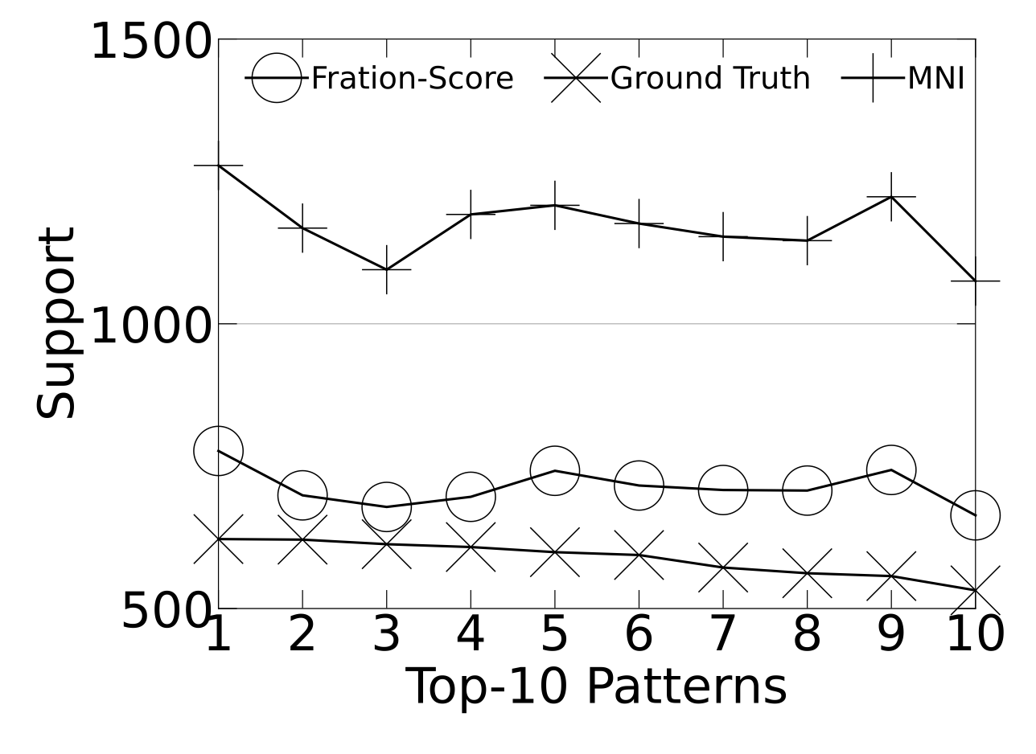
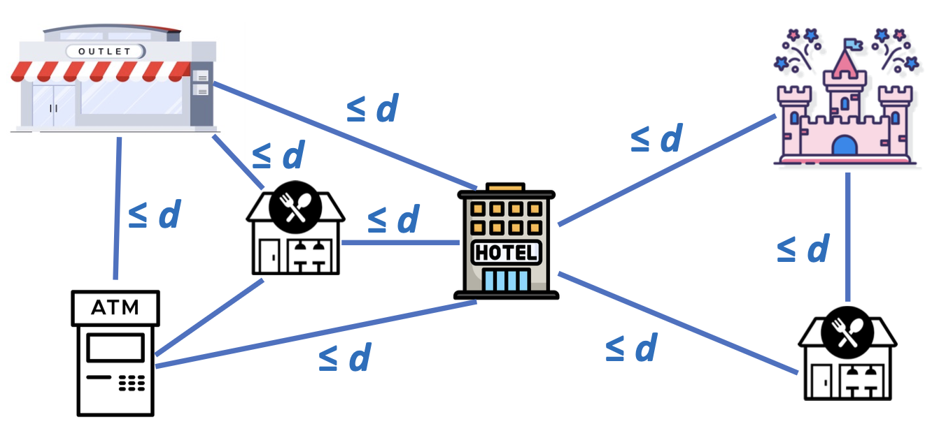
T-FSM
Solution: Fraction-Score
Extending from our prior work on colocation pattern mining
Notes:
Our solution is to extend the concept of Fraction-Score from our prior work on colocation pattern mining to the current setting. Note that colocation pattern mining requires every POI to be within distance d from each other, while our patterns are more general as shown on the right, which allows two clusters of locations around a hotel, one for theme park visit on a day of travel, and the other for shopping at an outlet on another day.
Fraction-Score is much tighter than MNI in our context since it avoids double counting an object involved in multiple matches.
In the figure on the left, we use a synthetic dataset for which we know the ground-truth support to compare the tightness of Fraction-Score and MNI, where we can see that Fraction-Score is much closer to the ground truth.
In our previous example, Fraction-Score can successfully recover the ground-truth support 2.

Slide 70
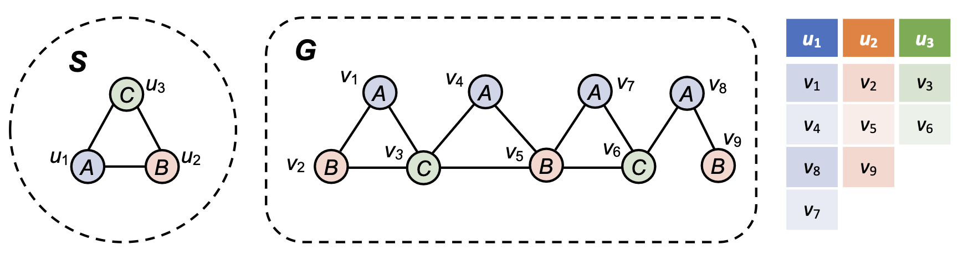


T-FSM
Domain Table
Each pattern = many subgraph-matching tasks
MNI = { 3, 2, 2 } = 2
If support threshold = 2, can skip evaluating v₈, v₇
If support threshold = 4, can skip the pattern after evaluating u₁
Parent domain table pushdown (pruned candidates of parent can be ignored)
Notes:
As we have previously seen, given a pattern, to check if it is frequent according to MNI or Fraction-Score
can be converted into the checking of whether a subgraph matching of the pattern can be found from each data vertex v that can match each query vertex ui
MNI is simply the smallest number of valid matches to any ui.
[click]
In this example, we can see that u1 has only 3 matches among the 4 blue data vertices since the blue candidate v8 cannot produce a triangle,
while u2 has only 2 matches since the red candidate v9 cannot produce a triangle. Taking the minimum among the 3 query vertices gives an MNI of 2.
[click]
Note that a lot pruning rules are possible here. For example, if we require MNI to be 4 to be frequent, then
if we can only find 3 candidate matches for v1, we can conclude that the pattern is infrequent without looking at u2 and u3.
On the other hand, we can stop checking the data vertices for each ui and move on to check ui+1 as soon as 4 matches have been found, even if there are numerous such matches for ui
------------- FINISH HERE… NEXT PAGE
Also, the domain table of an extended pattern can inherit the valid entries from the domain table of its parent pattern; this means that the domain table of a pattern would be maintained until the last child pattern has used it, which can make distributed implementation a bit trickier when pattern stealing is allowed to happen for load balancing, and we have an ongoing journal revision that proposes a technique to address this issue.

Slide 71
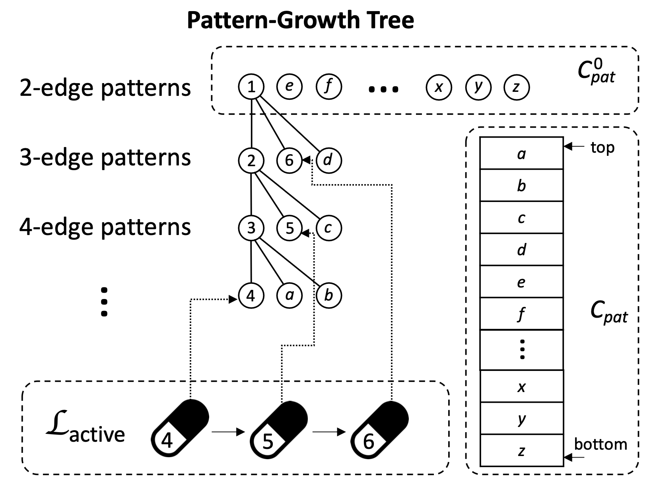
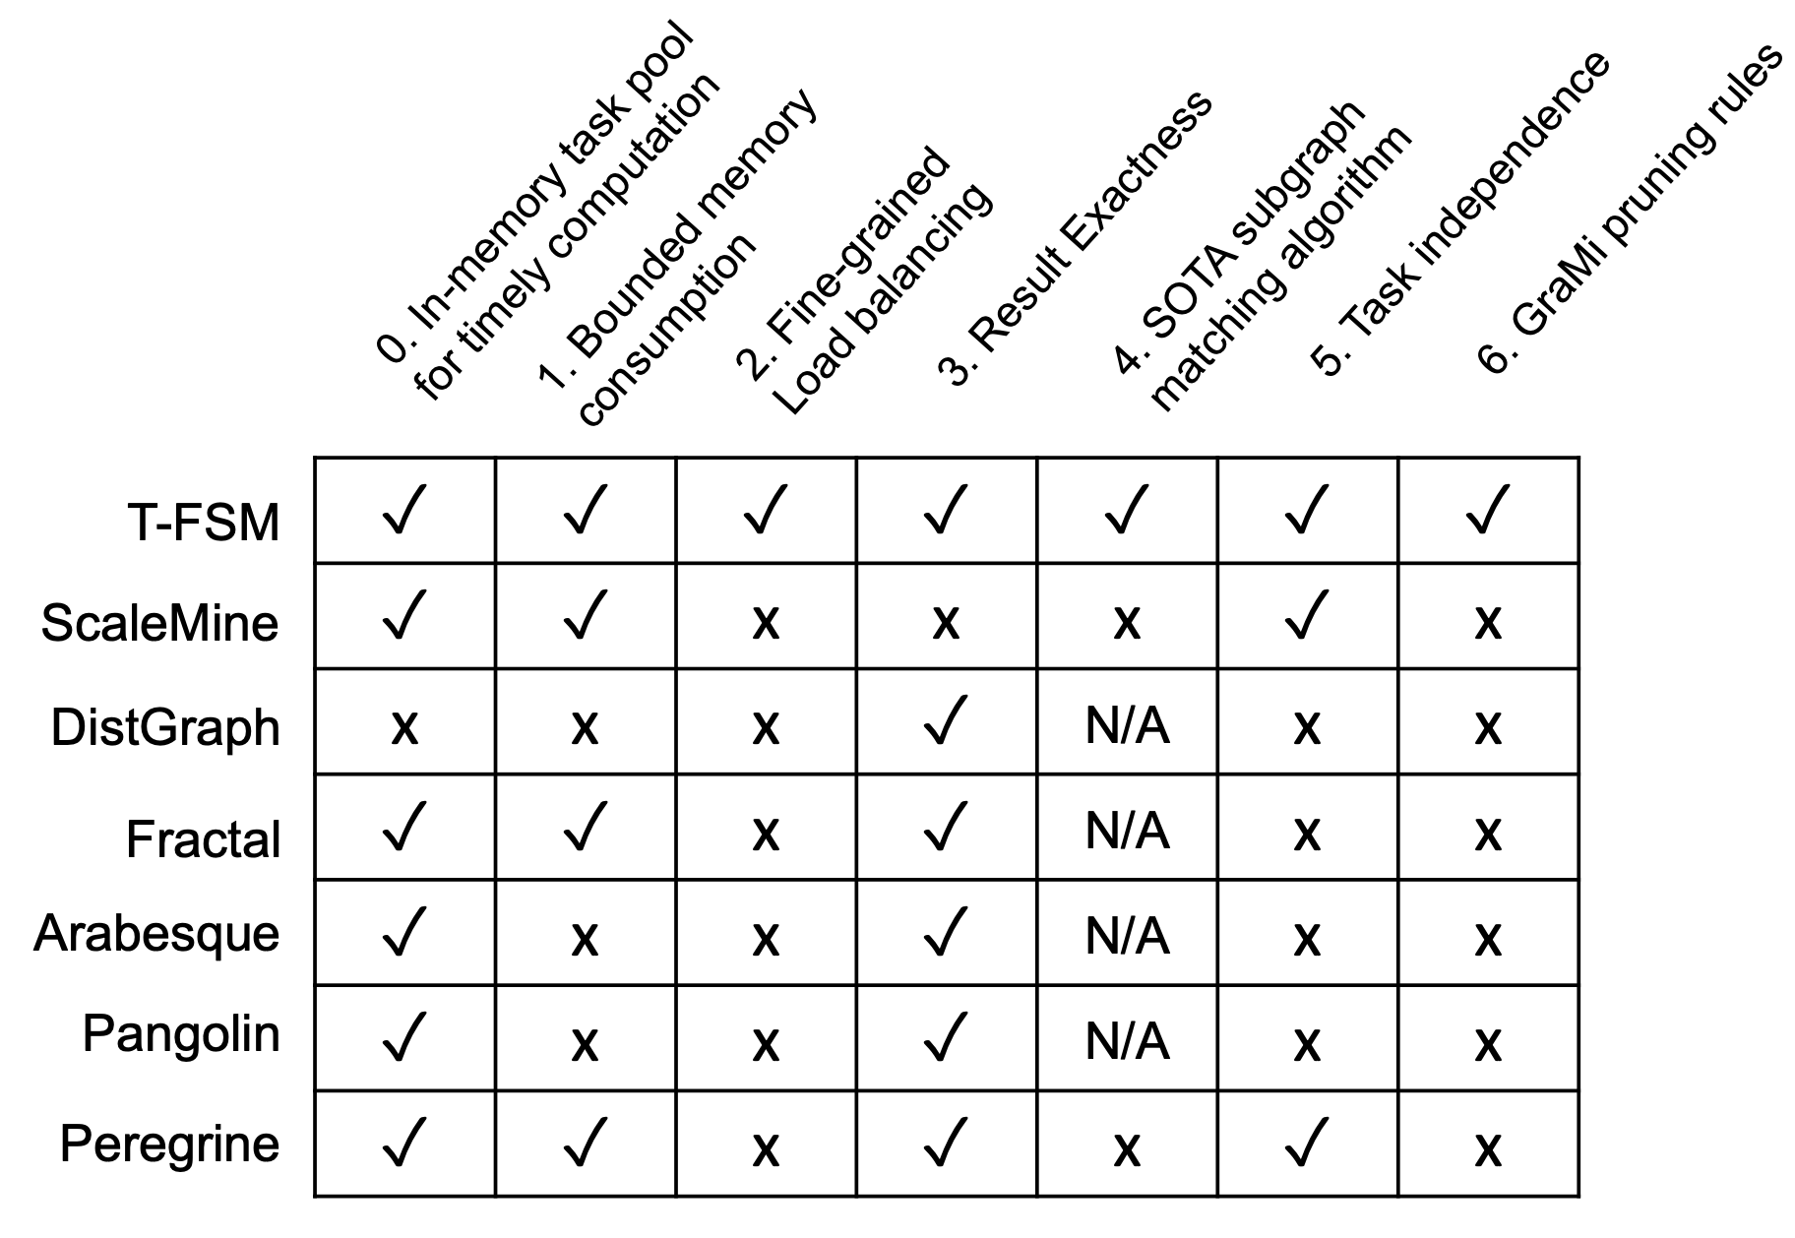

T-FSM
Task Management
Each active pattern has a pattern capsule
graph matching from v_{i}
head
v_{i}
tail
① fetch a task
?
② update status
L
_{active}
…
⑤ delete capsule
③ if pattern frequentness finalized
C_{pat}
…
⑥ pop
④ if frequent: extend & push
Initial 2-edge patterns (computed by the worker)
…
Notes:
In our T-FSM system, we only keep a bounded number of patterns active with their subgraph-matching tasks at any time
to limit memory consumption.
Here, the tasks of each active pattern is kept in a pattern capsule.
When a computing thread fetches a task to process [click],
it will obtain from the first pattern capsule in the list with an available task, so that patterns that were added earlier are prioritized for processing,
to finish early to make room for new patterns to be added to the active list.
Assume that a subgraph-matching task from the second pattern capsule is obtained, then [click] we will update the pattern status using the task result after task computation.
[click] If we can determine whether this pattern is frequent or not after its status update,
[click] we will extend the pattern following gspan's rightmost path extension strategy if it is frequent, and add the child patterns to a stack Cpat, which keeps the pending patterns to be processed
[click] The current pattern is then deleted from the active list since it finishes processing DA!!! [CONT. below]
Later if a computing thread cannot get any task after checking all the active pattern capsules,
[click]
a new pattern can be moved to the active list for task creation if the active list still has capacity.
[click] By organizing the pending pattern pool as a last-in-first-out stack, we can show that the memory consumption is bounded.
[click] The next question is how are tasks in a pattern capsule organized?

Slide 72
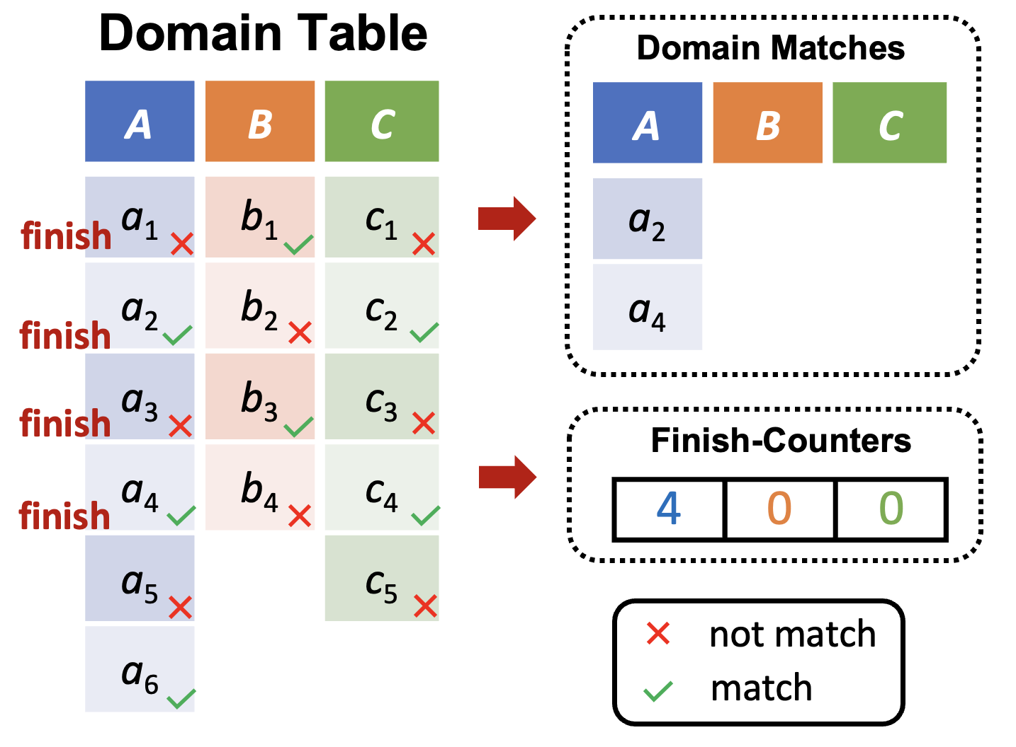
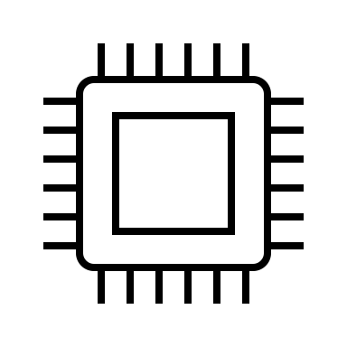
T-FSM
Pattern Capsule (for Each Pattern)
v₃
v₆
u₁
v₁
v₄
v₇
u₂
v₂
v₅
…
u₃
v₃
v₆
…
② fetch
① refill
v₇
v₂
v₅
Q_{reg}
compers
③ timeout & insert
v₄
…
…
…
…
L_{timeout}
② fetch
…
…
v₁
⑤ insert
…
④ timeout & decompose
v_{1a}
v_{1b}
Pattern Capsule
Notes:
Inside a pattern capsule, the subgraph-matching tasks are
[click]
initially spawned from vertices in the domain table when capacity allows.
[click] The tasks are fetched by the computing threads in the order such that u1’s tasks will be prioritized for processing before those of u2, which are in turn before those of u3, to facilitate early pruning.
Since "for" each query vertex ui, the goal is to find enough matched data vertices v that can produce a pattern match, if some v runs for a long time,
[click]
it will be temporarily added to a queue to skip its evaluation.
If finally, not enough valid matches can be found, those long running tasks will then be scheduled to resume execution.
[click]
Such a subgraph-matching task can still time out, so that it will be decomposed and the new tasks will be added back to the task queue for parallel processing to remove stragglers.

Slide 73
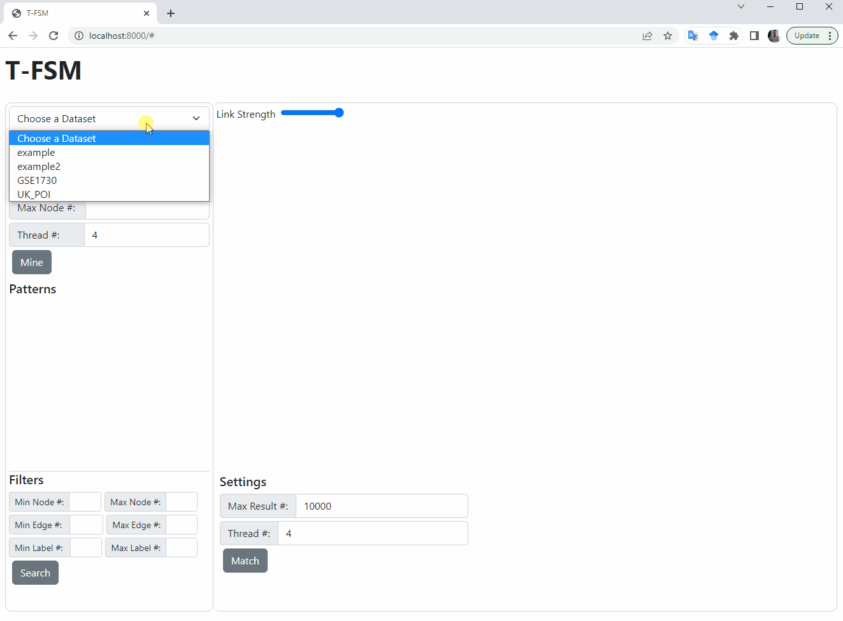
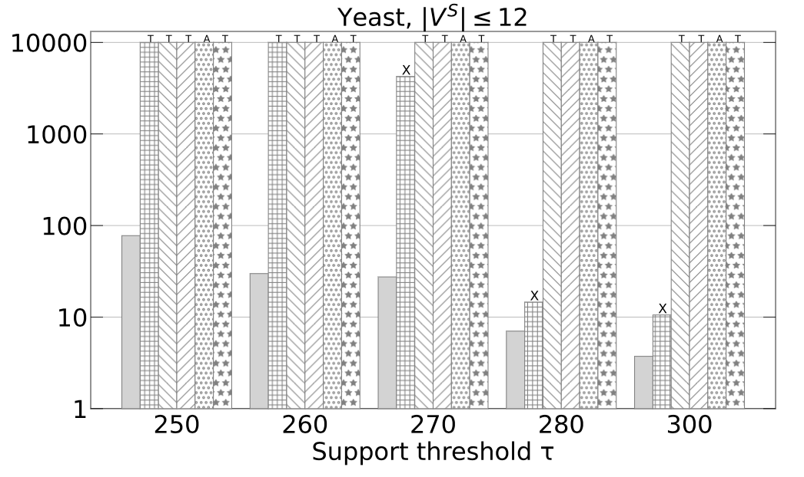

T-FSM
"FSM-Explorer: An Interactive Tool for Frequent Subgraph Pattern Mining from a Big Graph" (ICDE 2024 Best Demo Runner-up) Jalal Khalil, Da YAN, Lyuheng Yuan, Jiao Han, Saugat Adhikari, Cheng Long, Yang Zhou.
Notes:
T-FSM is orders of magnitude faster than existing systems, and we recently worked out a demo paper under submission to SIGMOD 2023.
Where one can mine the patterns using either MNI or Fraction-Score, search for the patterns lf interest, and examine its matched instances in the data graph in a batched manner
[describe more with the video?]

Slide 74



PrefixFPM
General Programming Framework for Frequent Pattern Mining
Subsequences, subtrees, subgraphs, submatrices
Notes:
The next T-thinker-based systems is PrefixFPM, which is for frequent pattern mining in a database with many transactions.
PrefixFPM provides a unified programming interface for users to specify the mining algorithms for various patterns.
We have applied PrefixFPM for mining frequent subsequences, subtrees, subgraphs and submatrices.

Slide 75
PrefixFPM
Prefix Projection (Illustration by Sequence DB)
SID | Sequence
s₁ | ABCBC
s₂ | BABC
s₃ | AB
s₄ | BC
SID | Sequence
s₁ | _BCBC
s₂ | _BC
s₃ | _B
SID | Sequence
s₁ | _CBC
s₂ | _C
s₃ | _
SID | Sequence
s₁ | _BC
s₂ | _
A
B
C
(d) D|_{ABC}
(b) D|_{A}
(c) D|_{AB}
(a) D
Projected DB
Transaction DB
Pattern: ABC
Pattern: ∅
Pattern: A
Pattern: AB
Notes:
The key idea of PrefixFPM’s design is prefix projection, which we illustrate here using sequential pattern mining.
Initially, the prefix is empty so we have all the sequences in the database.
[click]
If we grow the prefix with an element A, then s4 is gone since it does not contain A, and the matched positions of the other three sequences are recorded in the database projected by A [click].
[click]
If we further grow the prefix with B, then we can match B on the previous projected database, and a new database projected by AB is obtained.
Here, if the frequency threshold is 3 or less, AB is still a frequent pattern,
[click]
so we can grow it further with element C

Slide 76
PrefixFPM
Prefix Projection (Illustration by Sequence DB)
Alphabet is {A, B, C}
Transaction DB
∅
Projected DB
frequent
A
C
B
…
…
Projected DB
Projected DB
AA
AB
AC
A stack of projected DBs with shrinking size
…
infrequent
frequent
Incremental projected DB construction
Projected DB
Projected DB
ABB
ABC
Child-branches are embarrassingly parallel !!!
ABA
…
infrequent
infrequent
Notes:
Here is an example of the mining process
[…]
The benefit of this approach is that, each pattern extension only checks a small projected database rather than the entire database
[click]
The pattern to database matching is incremental from the previous matches rather than from scratch
[click]
The child branches in this search tree are totally independent and can run in parallel.

Slide 77


PrefixFPM
Deduplicate by canonical encoding
From Sequences to Graphs
Duplicated patterns for different sequences
BAB$D$$B$C$
BAB$D$$C$B$
BC$B$AB$D$$
canonical encoding
Notes:
Note that the idea of prefix projection carries over to tree and graph patterns, but since different pattern extension paths may lead to isomorphic patterns, redundancy avoidance is important.
Here, we show three tree patterns that are isomorphic if we ignore the children order.
We can define the one whose DFS serialization code is the smallest to be canonical, then we only need to expand a pattern if its DFS serialization code is canonical.
[click]
For tree patterns, canonicality is easy to check since only the pattern with children ordered exactly following the element order in the alphabet is canonical. This checking is more complicated for graphs but schemes like the DFS code of gSpan can be applied.
[click]
The other redundant branches will be pruned as shown on the right.

Slide 78
PrefixFPM
Task Parallelism
Alphabet is {A, B, C}
Transaction DB
∅
PDB-parallelism (root task)
Projected DB
A
B
C
…
…
Thread 3
Thread 4
AA
AB
AC
infrequent
…
Thread 2
ABA
ABB
ABC
Thread 1
Notes:
Here we show the mining process in PrefixFPM, where the first available node on the leftmost path will be fetched as a task by each computing thread for mining its subtree.
[click] x 4
If the mining by a task times out, the subtrees of the child nodes will be treated as new tasks and added to the system for parallel processing to avoid stragglers.
[click]
Initially when there are not many patterns, parallelism can come from the concurrent examining of data items for pattern matching.

Slide 79
Other Subgraph-Centric Systems
Beyond Our TLAT Systems
Earlier systems materialize intermediate subgraphs
Notes:
Here we show the mining process in PrefixFPM, where the first available node on the leftmost path will be fetched as a task by each computing thread for mining its subtree.
[click] x 4
If the mining by a task times out, the subtrees of the child nodes will be treated as new tasks and added to the system for parallel processing to avoid stragglers.
[click]
Initially when there are not many patterns, parallelism can come from the concurrent examining of data items for pattern matching.

Slide 80
Other Subgraph-Centric Systems
Beyond Our TLAT Systems
Recent systems start to utilize backtracking as much as possible
Notes:
Here we show the mining process in PrefixFPM, where the first available node on the leftmost path will be fetched as a task by each computing thread for mining its subtree.
[click] x 4
If the mining by a task times out, the subtrees of the child nodes will be treated as new tasks and added to the system for parallel processing to avoid stragglers.
[click]
Initially when there are not many patterns, parallelism can come from the concurrent examining of data items for pattern matching.

Slide 81
Other Subgraph-Centric Systems
Beyond Our TLAT Systems
For FSM:
Some systems materialize all subgraph patterns of size i,
and then aggregate them to obtain pattern frequency
Frequent ones generate patterns of size i + 1
Problems:
Anti-monotonicity? (e.g., MNI)
What if frequency is much higher than the threshold?
Notes:
Here we show the mining process in PrefixFPM, where the first available node on the leftmost path will be fetched as a task by each computing thread for mining its subtree.
[click] x 4
If the mining by a task times out, the subtrees of the child nodes will be treated as new tasks and added to the system for parallel processing to avoid stragglers.
[click]
Initially when there are not many patterns, parallelism can come from the concurrent examining of data items for pattern matching.

Slide 82
Other Subgraph-Centric Systems
Beyond Our TLAT Systems
Systems for:
Subgraph enumeration/matching
GPU Support
We will review systems in their intersection in Part II
Notes:
Here we show the mining process in PrefixFPM, where the first available node on the leftmost path will be fetched as a task by each computing thread for mining its subtree.
[click] x 4
If the mining by a task times out, the subtrees of the child nodes will be treated as new tasks and added to the system for parallel processing to avoid stragglers.
[click]
Initially when there are not many patterns, parallelism can come from the concurrent examining of data items for pattern matching.

Slide 83

Peregrine
Pattern-aware matching engine
Find partial ordering to break symmetries
Find the core (vertex-cover) of pattern
Match core with increasing IDs
Notes:
Peregrine is a single-machine parallel graph mining system publish in Eurosys'20. It called itself as a pattern-aware matching engine, which means each pattern must be analyzed which then guides the entire mining process later for better efficiency. So next I'll talk about what steps each pattern will go through.
[CLICK]
First one is to find partial ordering to break symmetries. This is very obvious since ....
[CLICK]
Second step is to find the core structure or vertex-cover of the pattern. You can conceptually understand the core as the "denser" part of the pattern. We tend to first match the dense part of the pattern since it can prune more vertices so that the search space is less. For example, ...
[CLICK]
Then we start the actual matching of the core structure but we need to match each vertex with increasing IDs to break symmetries. For example, ...

Slide 84


Peregrine
Comparing with existing distributed solutions
Speedups
Notes:
Now let's look at some of the experimental comparisons with existing distributed/parallel solutions. We can see that although these existing solutions uses much more hardware resources (CPUs, memory, networks), their performance are still worse than Peregrine. Therefore we can see the importance of considering symmetry, pruning etc. when designing your algorithm, not just scale on more and more machines.
[CLICK]
Peregrine also has ideal speedups. For example, ...

Slide 85
Part II: Systems for Subgraph Matching/Enumeration on GPUs
Structure Analytics
Da Yan yanda@iu.edu
Notes:
Good morning everyone! Welcome to our tutorial titled “Systems for Scalable Graph Analytics and Machine Learning: Trends and Methods”.
This tutorial is contributed by two groups from Indiana University Bloomington and the Chinese University of Hong Kong.
My name is Lyuheng Yuan from Indiana University Bloomington.
This tutorial is supposed to be delivered by 2 or 3 people, since it's a 3-hr tutorial. But unfortunately, there's some visa issues with the other authors, so I will be presenting all the materials in this long tutorial.
So hopefully you will enjoy this tutorial and don't get bored with the material.

Slide 86




GPU Architecture
Host
Device
CPU
Global Memory
PCI-e
Core 1
Core 2
Core 3
Core 4
RAM
Notes:
Inside a pattern capsule, the subgraph-matching tasks are initially spawned from vertices in the domain table when capacity allows. If a task times out, it will be decomposed and the new tasks will be added to a timeout task list for load balancing.
The tasks are fetched by computing threads in the order such that u1’s tasks will be prioritized for processing before those of u2, which are in turn before those of u3, to facilitate early pruning.

Slide 87



Subgraph Matching/Counting
Various Patterns:
Pattern P
Data Graph G

Slide 88
A Series of CPU works
Arabesque [SOSP’15]
G-Miner [EuroSys’18]
G-thinker [ICDE’20]
Fractal [SIGMOD’20]
Peregrine [EuroSys’20]
GraphPi [SC’20]
…
Notes:
There’re a series of CPU existing works, here I only list a few, there’re a lot more than this. Because of the time constraint, I cannot introduce all of them.
I think you won't be interested in these a bit earlier works, so we will directly skip them and talk about something more interesting.

Slide 89
Recent GPU Solutions
BFS-style
CuTS [SC’21]
VSGM [SC’22]
DFS-style
STMatch [SC’22]
EGSM [SIGMOD’23]
GraphSet [SC’23]
T-DFS [ICDE’24]
Notes:
We've seen some of the works on CPUs. As more and more advanced GPU coming out, researchers start to figure out if there're better and more efficient, more scalable GPU solutions for the graph mining problems. So in the rest of the section, we will be focusing on the GPU solutions, which is more interesting than CPU solutions.
There’re 2 main categories for GPU solutions, namely BFS-style and DFS-style. For each category, we will cover some representative works in recent 3 years to understand what are the differences, what’s the pros and cons for each category.

Slide 90

CuTS
Trie-based Data Structure maintained in GPU
Many paths share common parents/prefixes
index array
nodeID array
Notes:
First work we'll be looking is called CuTS. It proposes to maintain a trie-based data structure in the GPU memory for the keeping the intermediates results or partial matches. For example, ...
[CLICK]
There're 2 array associated with each layer. The orange array is called index array. It's used to indicate the which index it belongs on the previous layer. For example, ...
[CLICK]
The blue array is called nodeID array, which records the actual vertexID.
[CLICK]
The benefit of maintaining such trie-based DS is because many paths share common parents or prefixes so that we save a lot of space and avoid saving same prefixes over and over again.

Slide 91

CuTS
Hybrid BFS-DFS strategy
Chunking allows processing larger graphs without sacrificing performance.
Layer 0
…
Layer 1
…
Layer 2
Chunk 1
Chunk 2
Chunk 3
May still overflow the memory in deeper levels!
Notes:
CuTS adopts a hybrid BFS-DFS strategy. Here's how it works.
Suppose we have 4 elements on layer 0.
[CLICK]
And at layer 1 we extend to this many vertices.
[CLICK]
And at layer 2 we further extend to this many vertices.
If we continue to extend to the next layer, it may overflow the GPU memory and the program crashes.
[CLICK]
To avoid this, we can divide the array into several chunks and process 1 chunk at a time. For example, ....
[CLICK]
Then the GPU can start process chunk 1, after it's done,
[CLICK]
process chunk 2, after its done.
[CLICK]
process chunk 3.
[CLICK]
The benefit of this chunking is we can process larger graphs because we can avoid memory overflowing without sacrificing performance.
[CLICK]
However, ....

Slide 92

VSGM
What if size of input graph is beyond GPU memory?
Partitioning the graph
Intra-partition search
Inter-partition search
Inter-partition search is bottleneck!
Notes:
VSGM discusses the problem when the input graph size is beyond GPU memory, so we cannot load entire graph into the memory. Then the question is how should we mine subgraph structures in these large graphs?
[CLICK]
One straightforward idea is to partition the input graph into several pieces. Then the searching can be split into 2 categories,
[CLICK]
which are intra-partition search and inter-partition search.
[CLICK]
Now let's look at how each of them perform in the experiments.
[CLICK]
If we look at the left arrow, apparently, over 90% of the execution time is spent in inter-partition search. This is because inter-partition search requires frequently host-to-device data transfer which is way slower than computation.
Similarly, If we look at the right arrow, ....
[CLICK]
So, we find that inter-partition is the bottleneck.
Therefore, partitioning the input graph doesn't seem promising and it's hard to optimize the inter-partition search. Do we have better solutions?

Slide 93
VSGM
Solution: Partitioning the Search Space
Minimum k-hop view of a pattern
How many hops from a source vertex should be visited in order to match P
1
1
1
2
Source Vertex
0
1
+1
0
2
1
2
Source Vertex
1
k = 2
k = 3
Notes:
The answer is yes. Instead of partitioning the input graph, we can partition the search space. Before that, I'll introduce a definition called minimum k-hop view of a pattern, which describes how many hops from a source vtx should be visited in order to match P.
[CLICK]
For example, ... [CLICK] so k = 2.
[CLICK]
As another example, … so k = 3.

Slide 94

VSGM
Partitioning search space
Bin-Packing Problem
I need an array of length 15 to store 0’s 2-hop neighbors.
Notes:
We know that each pattern needs to know k-hop subgraph from the source vertex, and the source vertex can be matched to any vertex. The simplest way is every time just to load the k-hop subgraph of one vertex. For example, here shows the 2-hop of a pattern.
[CLICK]
15 means it requires an array of length 15 to store 0's 2-hop neighbors. Why it's 15?
[CLICK]
if we sum these 5 numbers together, each number means the #neighbors of each vertex.
But loading 1 vertex at a time is too slow, do we have more efficient way to do this?
[CLICK]
So the problem is converted into a bin-packing problem.

Slide 95

VSGM
What is bin-packing problem?
Input: weight[] = {4, 8, 1, 4, 2, 1}
Bin capacity c = 10
First bin contains {4, 4, 2} and second bin {8, 1, 1}
How are these 2 problems related?
Notes:
So first question is what is bin-packing problem? ...
[CLICK]
the result is ...
[CLICK]
Next question is how are these 2 problems related?

Slide 96
VSGM
NP-hard
Next Fit
Vertex Ordering matters!
Bin Capacity = 15
Bin #1
Bin #2
Bin #3
Bin #4
Bin #5
Notes:
In the same example, suppose the bin capacity is 15. How do we merge these vertices in order to keep the # bins as small as possible, because each bin is a data movement from CPU to GPU.
[CLICK]
The bin-packing problem is a NP-hard, so researchers came up with some heuristic way to solve it.
[CLICK]
A very straightforward way is called next fit. Here how it works:
[CLICK]
Bin #1,2,3,4,5
So we end up using 5 bins in this problem, but the optimal solution is 3. Why are we so deviated from the ground truth?
[CLICK]
The reason is we don't select a good vertex ordering. With a good ordering, you can easily merge those vertices with common neighbors, so that have less redundant storage.

Slide 97

VSGM
Closely connected vertices have closer IDs
Clustering problem
K-means (on 0-1 vectors of |V|-dim, cosine distance)
Notes:
So in other words, ...
[CLICK]
So this became a cluster problem where we need to find clusters/communities and put those clusters together in a consecutive sequence.
[CLICK]
The paper uses k-means and k-means++ as a variant for clustering. The details is skipped.
[CLICK]
The experimental results is shown here, we can see that cluster is every effective in reducing # of bins. ….

Slide 98

VSGM
CPU-GPU Pipelined execution
Multi-Producer-Multi-Consumer (MPMC)
Consumers
Producers
Notes:
VSGM also use a pipelined execution strategy called MPMC.
Remember we talk about each GPU needs to load a bin of vertices and their neighbors into the memory, rather than the whole graph.
So on the CPU side, some worker threads will build these bins and put them in a buffer
[CLICK]
We called such workers as producers. And when the GPU becomes idle, it will get one bin from the buffer to its memory and start computation.
[CLICK]
So the GPUs are consumers. GPUs keep on loading bins from the buffer until the buffer is empty. Then all match results are found.

Slide 99

VSGM
Hybrid BFS-DFS matching on GPU
Layer 0
Layer 1
Layer 2
Out of Memory!
Notes:
VSGM also use a hybrid BFS-DFS matching but it has more fine-grained memory control than the CuTS solution, here’s how it works.

Slide 100
VSGM
Hybrid BFS-DFS matching on GPU
Layer 0
Layer 1
Layer 2
Layer 3
Out of Memory!

Slide 101

VSGM
Hybrid BFS-DFS matching on GPU
Layer 0
Layer 1
Layer 2
Layer 3
Avoid overflow in deeper levels!

Slide 102
VSGM
Hybrid BFS-DFS matching on GPU
Layer 0
Layer 1
Layer 2
Layer 3

Slide 103
VSGM
Hybrid BFS-DFS matching on GPU
Layer 0
Layer 1
Layer 2

Slide 104
Hybrid BFS-DFS

Slide 105

G²-AIMD
Degeneracy Ordering
Chunk 1
Chunk 2
…
Chunk n
A chunk can still explode memory!!
Notes:
Inside a pattern capsule, the subgraph-matching tasks are initially spawned from vertices in the domain table when capacity allows. If a task times out, it will be decomposed and the new tasks will be added to a timeout task list for load balancing.
The tasks are fetched by computing threads in the order such that u1’s tasks will be prioritized for processing before those of u2, which are in turn before those of u3, to facilitate early pruning.

Slide 106
G²-AIMD
Adaptive Chunk Size
Inspired by additive-increase/multiplicative-decrease of TCP congestion control
Notes:
Inside a pattern capsule, the subgraph-matching tasks are initially spawned from vertices in the domain table when capacity allows. If a task times out, it will be decomposed and the new tasks will be added to a timeout task list for load balancing.
The tasks are fetched by computing threads in the order such that u1’s tasks will be prioritized for processing before those of u2, which are in turn before those of u3, to facilitate early pruning.

Slide 107
G²-AIMD
Subgraph-centric API
subgraph_generate
subgraph_extend
Swapping Buffers
B_{read}
B_{read}
…
{a}
{b}
{c}
{a, b}
{a, c}
{a, d}
{b, c}
Extending Subgraphs
Extending Subgraphs
B_{write}
{b, c}
{b, d}
{c, d}
B_{write}
{a, b, c}
{a, b, d}
{a, c, d}
…
{a, b}
{a, c}
{a, d}
Notes:
Inside a pattern capsule, the subgraph-matching tasks are initially spawned from vertices in the domain table when capacity allows. If a task times out, it will be decomposed and the new tasks will be added to a timeout task list for load balancing.
The tasks are fetched by computing threads in the order such that u1’s tasks will be prioritized for processing before those of u2, which are in turn before those of u3, to facilitate early pruning.

Slide 108
Recent GPU Solutions
BFS-style
CuTS [SC’21]
VSGM [SC’22]
DFS-style
STMatch [SC’22]
EGSM [SIGMOD’23]
GraphSet [SC’23]
T-DFS [ICDE’24]

Slide 109
DFS-style
Creating Stacks on GPU
Notes:
When we talk about DFS implementation, we first need to figure out how to build a stack on GPU.
Data graph G has a series of vertices to be processed. Each warp its dedicated stack.
[CLICK]
Warp 1 is allocated with v1, …, v4 and it can start processing these 4 vertices.
[CLICK]
There are also counters like Size and Iter referring to total size of the array and which position is under computation right now. For example,
When these 4 vertices are completed, the warp will request for next batch.

Slide 110
DFS-style
Challenges of Load Balancing
Each task (vertex) may have drastically different size of subtree
How to avoid such stragglers?
Decompose computation to idle warps
Different strategies adopted by existing works
STMatch [SC’22]
EGSM [SIGMOD’23]
T-DFS [ICDE’24]
Notes:
The biggest challenge of using DFS is load balancing issues, that is each task may have drastically different sizes of subtree.
[CLICK]
Those subtrees with higher workloads are more likely to become stragglers.
[CLICK]
A straightforward way to avoid stragglers is to decompose computation to idle warps.
[CLICK]
Therefore researchers have come up different strategies on how to decompose heavy workloads to idle warps.

Slide 111
STMatch’s Strategy (Half Steal)
Find the highest level with unprocessed vertices in Warp i ’s stack
Take half
Need locking to protect stack
Imposing busy-waiting locks
Notes:
Now let’s take a look at how STMatch does this. We call this strategy as ”Half Steal”. Idle warp will probe the stack of other busy warps, and try to steal half of the remaining workload. In this example, warp j is idle and it finds warp i has remaining workload, so it steals v2 and v3 to its own stack and continue processing.
[CLICK]
However, we notice that in order to protect the stealing, we need to manually impose busy-waiting locks on GPU which can greatly undermine the performance.

Slide 112
EGSM’s Strategy (New Kernel)
If fanout F > 1024, create new kernel with F/32 warps, each warp will process 32 vertices
Create new stack spaces while launching a new kernel
Lack of space
Hard to tune the threshold F
Unexpected program failures
Notes:
Another work called EGSM uses a different strategy. We call it as “new kernel”. For example, if the fanout F of the tree is greatly than 1024, they will launch a new kernel with F/32 warps, so each warp will process 32 vertices.
[CLICK]
However, we notice that every time they launch a new kernel, new stack space need to be allocated as well since we don’t want the new kernel interfere the original kernel. So when the launched kernel increases, you will have less and less available memory when may lead to memory overflow.
[CLICK]
And the threshold F needs to be tuned for every graph to achieve the best performance which requires some manual effort.
[CLICK]
We also encounter some unexpected program failures while running the code which implies the implementation is not stable.

Slide 113



T-DFS’s Strategy (Timeout)
Automatically detect stragglers
Timeout mechanism
If a task runs longer than τ, decompose it
v₀
v₀
<v₀, v₁, v₅₁>
<v₀, v₁, v₅₂>
v₁
front
v₁
v₅₄
back
v₅₄
v₅₅
v₅₅
v₅₆
v₅₆
<v₀, v₁, v₅₃>
<v₀, v₅₄>
Q_{task}
v₂
<v₀, v₅₅>
v₂
v₅₀
v₅₁
…
v₅₀
v₅₁
v₅₂
v₅₃
…
v₅₂
v₅₃
<v₀, v₅₆>
…
…
…
…
Notes:
T-DFS design a strategy that can automatically detect the stragglers without tuning and avoid the using of busy-waiting locks. We call it as timeout mechanism. Here’s how it works.
[CLICK]
When we start processing a task, we record its starting time. After it runs longer than a certain threshold tau, we stop processing it and decompose it into a lock-free queue.
[CLICK]
[CLICK]
For example, in this figure, we start from v0 and till v51 we realize this task times out, the remaining 6 subtasks in red shown on the right will be inserted into queue inside GPU memory.

Slide 114
T-DFS’s Strategy (Timeout)
Automatically detect stragglers
Idle warps prioritize spilled tasks over new chunks
Notes:
T-DFS design a strategy that can automatically detect the stragglers without tuning and avoid the using of busy-waiting locks. We call it as timeout mechanism. Here’s how it works.
[CLICK]
When we start processing a task, we record its starting time. After it runs longer than a certain threshold tau, we stop processing it and decompose it into a lock-free queue.
[CLICK]
[CLICK]
For example, in this figure, we start from v0 and till v51 we realize this task times out, the remaining 6 subtasks in red shown on the right will be inserted into queue inside GPU memory.

Slide 115
Load Balancing Strategies
Notes:
To test the effectiveness of different load balancing strategies, we implement all 4 strategies on top of our framework, namely timeout stealing, half stealing, new kernel and without any stealing.
It’s obvious that timeout stealing is the best among all 4 strategies by at least 2 times faster. Half stealing and new kernel are better than w/o stealing, but they have their own drawbacks.
For example, …

Slide 116

STMatch
DFS-style stack-based search on GPU
Notes:
Now let’s look at some other techniques that STMatch uses.
STMatch also uses a DFS-style or stack-based implementation on GPU where a warp is a basic processing unit.
So we first allocate a dedicated space in the memory for every warp, and each warp will request some workload and then it can start processing.
For example, …

Slide 117
STMatch
Challenge #1: Load balance among warps (Covered)
Challenge #2: Thread underutilization within warps
A warp has 32 threads
Average degree < 8
∩
iterate
Not sufficient work for a warp, esp. in deeper levels
Notes:
There’re several limitations for doing subgraph matching on GPU. First one is the load balance issue among the warps. We just covered how STMatch resolves this problem, which is using locks to protect stealing between and donor and receiver. But this approach is not so good.
[CLICK]
So the second challenge is known as the thread underuntilization within warps.
[CLICK]
The reason why this problem happens is a warp has 32 threads. However, real-world graphs are usually very sparse. Although they may have very high-degree vertices, its average degree is usually below 8.
Suppose we assign one vertex to a warp, each thread handle one neighbors of a vertex, the most of threads are just idle, because only 8 threads in a warp has some work to do.
[CLICK]
If we want to intersect these 2 arrays on GPU.
[CLICK]
If you don't know how to do that, each thread will handle one vertex, it will do a binary search in another array. If found, the result must appear in the result array. If the array is long, the thread will iterate to the next location for a new round.
[CLICK]
If the blue array is short, that means there's not sufficient workload for a warp, especially on deeper levels since there're more constraints on deeper levels, so the array will be shorter.

Slide 118
STMatch
Loop Unrolling
∩
Warp 1
∩
Warp 2
∩
After Unrolling
Prefix array to indicate which intersection it belongs to
Notes:
STMatch proposes a technique called loop unrolling to improve the thread utilization.
Suppose ....
[CLICK]
After unrolling, we will concatenate these 2 arrays together can assign these combined workload to only one warp. By doing this, the length of array can be much longer than before, therefore, every warp has sufficient workload to do.
[CLICK]
But we need additional prefix array to indicate which intersection is belongs to.

Slide 119







STMatch
Compute an intermediate set $S=N\left(u_{0}\right)∩N(u_{1})$
Challenge #3: Redundant computation
$$u_{0}$$
$$N\left(u_{0}\right)∩N(u_{1})$$
$$u_{2}$$
$$u_{3}$$
$$u_{1}$$
$$N\left(u_{0}\right)∩N\left(u_{1}\right)−\{u_{2}\}$$
Notes:
The third challenge is known as redundant computation.
Suppose we want to match this pattern to some data graphs. we match it by the order u0, u1, u2 and u3.
[CLICK]
u2 can be represented as ...
[CLICK]
u3 can be represented as ...
We can find that the red intersection is both used by computing u2 and u3.
[CLICK]
So a clever way to do it is to compute a intersection set ...

Slide 120


STMatch
Compute an intermediate set $S=N\left(u_{0}\right)∩N(u_{1})$
Challenge #3: Redundant computation
$$u_{0}$$
$$S$$
$$u_{2}$$
Build a dependency graph for query graph
What intermediate sets should be computed
$$u_{3}$$
$$u_{1}$$
$$S−\{u_{2}\}$$
More opportunities to remove redundancies?
Notes:
Now the u2 is represented by S, and u3 is represented by S - {u2}.
[CLICK]
In order to avoid redundancy, STMatch first build a dependency graph for a given query graph. And a query planner will figure out what intermediate set should be pre-computed to save some effort.
[CLICK]
This seems reasonable, but do we really get rid of all redundancies?

Slide 121

GraphSet
Pattern Oblivious
Earlier works (e.g., Arabesque [SOSP’15])
Pattern Aware
Analyzing pattern and their structural information to construct a schedule (search order and symmetry order) to achieve efficient mining
AutoMine [SOSP’19]
GraphZero [OSR’21]
Peregrine [EuroSys’20]
GraphPi [SC’20]
Notes:
The answer is no. Let's look at a more recent work called GraphSet published in SC'23. It first splits existing graph mining system into 2 categories, known as pattern oblivious and pattern aware. In pattern oblivious works, they don't analyze the pattern itself, it just match the pattern w.r.t. its vertex ID, like it first match 0, then 1, 2 and so on. Earlier works often adopts pattern-oblivious approach such as Arabesque.
Another category is called pattern aware where it first analyze the pattern and its structural information to design a schedule/plan. The plan includes the most efficient search order and some symmetry order. Obviously the pattern-aware system are faster and more efficient than the pattern-oblivious because it takes the pattern itself into consideration.
[CLICK]
A series of more recent works adopts such approach, such as AutoMine, GraphZero, Peregrine, GraphPi and so on.

Slide 122

GraphSet
Limitations on Existing Pattern-Aware Soluions
Complex Control Flows in DFS (e.g., for, if)
Such control flows are unfriendly to GPUs!
Can we reduce control flows?
Notes:
But there're still some limitations for the pattern aware systems. The most notable one is known as complex control flows.
For example, this is the pseudo-code of this pattern matching to some data graphs. The match order is a->b->c->d->e->f. If you can see it clearly, it first ...
[CLICK]
We find that there're a lot of for and if controlling complex logic flow to match this pattern. Such control flows are very unfriendly to GPUs. because GPU is supposed to have regular computation on consecutive data.
[CLICK]
Then an intuitive question to ask is can be reduce such complex control flows to make it more friendly on GPU?

Slide 123
GraphSet
Inclusion-Exclusion Principle (IEP)
Given 2 sets A and B, pick 1 element each from A and B.
How many different combinations without duplication?
Result = |A| * |B| – |A ∩ B|
Given 3 sets A, B and C, pick 1 element each from A, B and C.
How many different combinations without duplication?
Result = |A| * |B| * |C| – |A| * |B ∩ C| – |B| * |A ∩ C| – |C| * |A ∩ B| + 2 * |A ∩ B ∩ C|
Notes:
The answer is yes. Before we go into the details, we need to go through a type of problems that is very relevant to this problem, which is called inclusion-exclusion principle or IEP in short. To understand this, we can first look at a concrete example.
[CLICK]
Given a sets A and B consists of some numbers, we pick 1 element each from A and B. The question is how many different combinations without duplication can we get?
If we solve this problem by write program, we can have 2 nested for loop and a if condition, we skip. But if we directly use this conclusion, A*B-A inter B, it becomes a much easier problem.
[CLICK]
On the bottom, we have 3 sets, ...
The results is also given here. But if you write in program, you need 3 nested for-loop and several if-condition for filtering, which adds more complex control-flow into your program.

Slide 124

GraphSet
Notes:
Ok, How is the IEP related to our graph mining problem?
If you look at the green square, we can find that it's doing exactly what I just mention that we take 3 elements from 3 different sets without duplication.
[CLICK]
By using the conclusion we just see, we can transform the program in green square into this equation and they're equivalent. But the benefit is we get rid of all control logic in the green square.

Slide 125


GraphSet
Common intersection elimination
Notes:
The next technique we can apply is called common intersection elimination.
For example,

Slide 126

GraphSet
Notes:
Therefore, we can further simplify the program in green square into blue square on the right, where loopD, loopE, and loopF are all disappeared.
The reason we can do such simplification is we know these intersections are equivalent, so we don't need to compute the same result over and over again.

Slide 127

GraphSet
Set difference simplification
Notes:
Another technique is called set difference simplification.
...
[CLICK]
An intuition for this is ...

Slide 128

GraphSet
Notes:
By further simplifying this set difference operation, the program can be simplified on the right where no set difference is ever needed.
By now, we can see how effective it is by analyzing the pattern graph, we can get rid of most complex control logic. This program will be significantly faster than our original program and it can fully exploit the massive parallelism on GPU devices.

Slide 129
GraphSet
CPU analyzes the pattern and generates efficient code running on CPU/GPU
A warp (32 threads) computes a set operation
148.47x faster than Peregrine
3.17x faster than GraphPi
10-2,000x faster than GPU baselines (including CuTS).
Notes:
In GraphSet paper, since each pattern is different, so the final optimized program for different patterns are also gonna be different. Therefore it's hard to write one program which fits all patterns. So it first analyzes the pattern on CPU and CPU will generate efficient code running on CPU/GPU. This is more flexible and more efficient comparing to write only one program and use that to fit all patterns.
[CLICK]
Same as before, a warp will compute a set operation.
[CLICK]
it's 148x faster than Peregrine, and 3x faster than GraphPi.
[CLICK]
it's also 10-2000x faster than other GPU baselines, including CuTS.

Slide 130
EGSM
Specially designed for labeled subgraph matching
Key difference to unlabeled subgraph matching
2 node labels bring stronger filtering/pruning
Edge-centric filtering (2 labels, degrees)
Build an auxiliary index for fast lookup
What index is GPU-friendly?
Notes:
We have talk about a series of works in unlabeled subgraph matching, where we don't assume any label constraint. Or in other words, we assume every vertex has the same label. But in some real-world graphs, or real scenario, each vertex/edge is associated with a label to represent their category or information. Therefore, in such scenario, we need to take the label into consideration. EGSM is a recent work targeting the label subgraph matching scenario.
[CLICK]
The key difference to unlabeled subgraph matching is that the labels of 2 nodes will bring stronger filtering/pruning power where we can use such constraint to prune a lot of unqualified edges.
[CLICK]
So this paper adopts an edge-centric filtering where we use the labels and degree of 2 nodes to filter those unqualified edge candidates.
[CLICK]
In order to support fast lookup on edge candidates, it proposes to build an auxiliary index so that we can know which edge is qualified to be matched for the next round.
[CLICK]
But building an index is not easy, especially on GPUs. The next question is what index is GPU-friendly and satisfies our requirements?

Slide 131


EGSM
Cuckoo Trie Index
How to build CT-index is skipped
Bucket 1
Bucket 2
Notes:
This paper proposes to build a Cuckoo-trie index or CT-index. How to build such index is skipped, you can refer their paper for more details. I will discuss how to read from this index.
If you look at the bucket on the left, it contains 3 arrays. Cuc is the array to read source vertex. For example, ...
Off array is used to read the starting location and length in the third array. For example, ...
Nbr array is used to read destination vertex. For example, ...
We can have multiple of these buckets depending on the number of candidate edges.

Slide 132



EGSM
Hash Func 1
Hash Func 2
v
$H_{1}$(.)
$H_{2}$(.)
Cuckoo Trie Index
Bucket 1
Bucket 2
Notes:
Now let's talk about how to read from such index. We expect very fast lookups from this index.
At the beginning, we have 2 hash functions used to hash a vertex into some bucket numbers/IDs.
[CLICK]
Suppose we have a vertex v, we first put v into the first hash function
[CLICK]
and it will map v into some bucket ID, let's assume it's the first bucket.
[CLICK]
If we can find v in the first bucket, the it's done. It can read those candidate edges by the offsets array and nbr array.

Slide 133

EGSM
Hash Func 1
Hash Func 2
v
$H_{1}$(.)
$H_{2}$(.)
Cuckoo Trie Index
Must in this bucket
Bucket 1
Bucket 2
Notes:
However, if v is not found in the first bucket,
[CLICK]
we then put v into the second hash function,
[CLICK]
and it will map v to some other bucket ID, and by definition of cuckoo hashing, v must be in that bucket. And it can read those candidate edges by the offsets array and nbr array.

Slide 134


EGSM
How effective is Cuckoo Trie Index?
Our finding: only effective when query graph is large (e.g., ≥ 10 vertices)
Notes:
Now let's look at how effective is the cuckoo-trie index?

Slide 135

Thank you !
Questions?
Da Yan yanda@iu.edu
Notes:
This concludes the first part of the tutorial.
Thanks for your attention, and do you have any questions?

